Slide 1
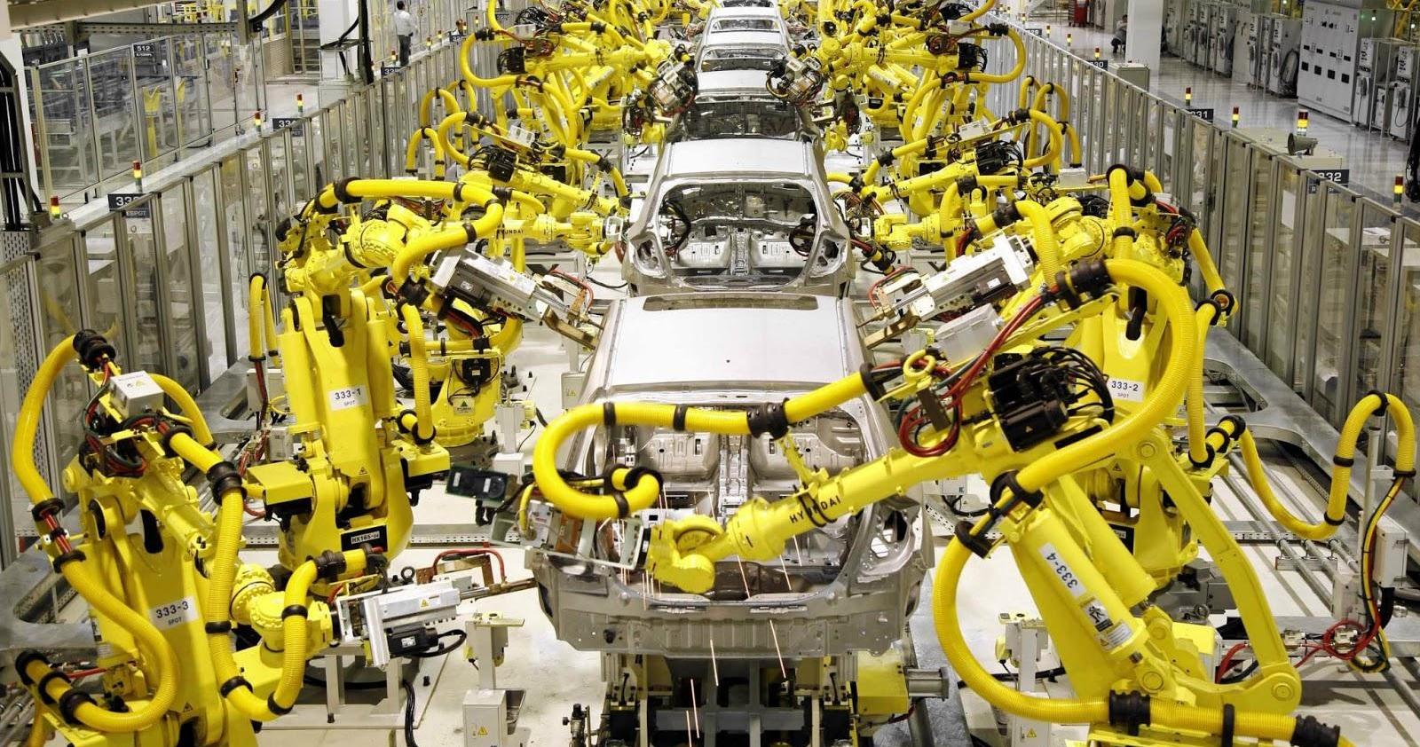
Automated World
By Matty and Sean

Slide 2
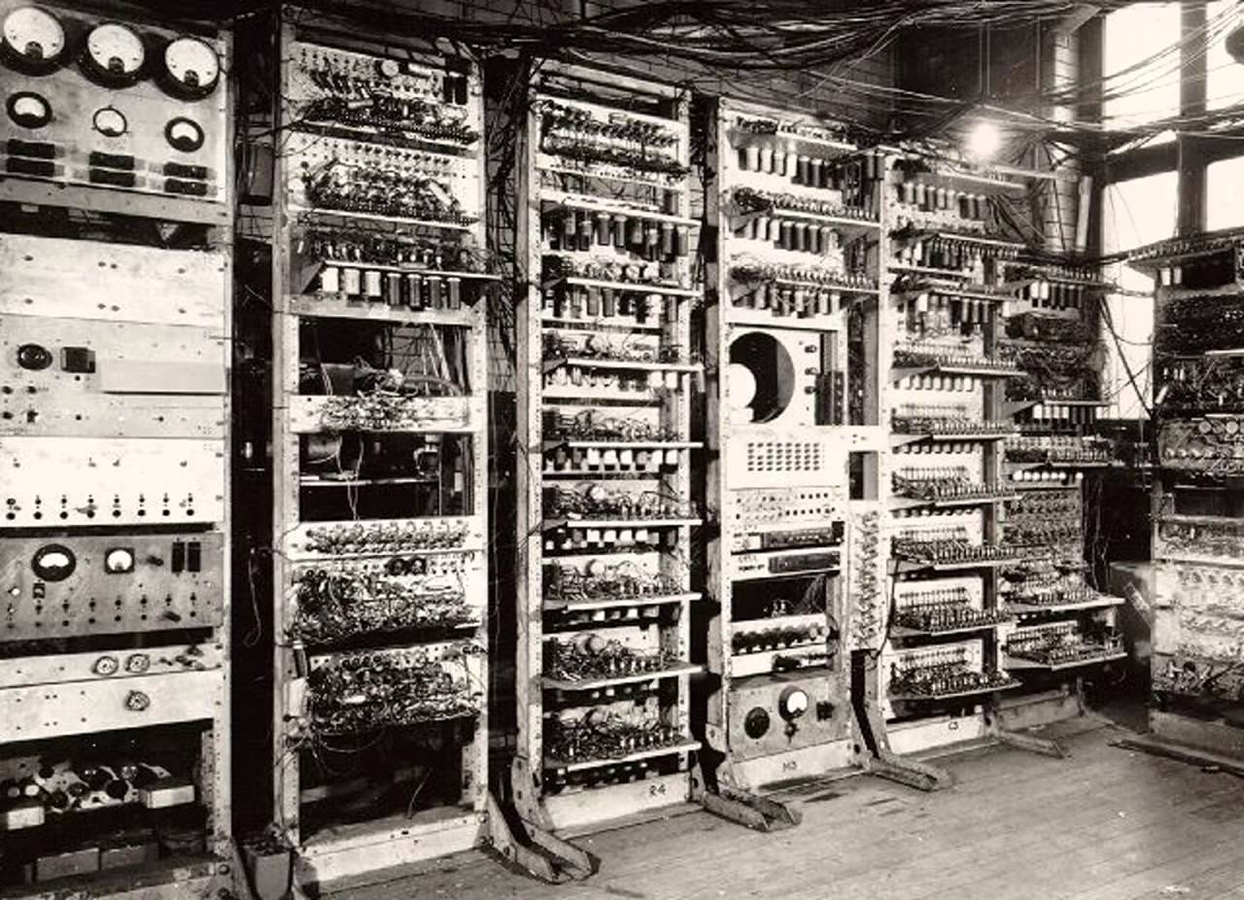
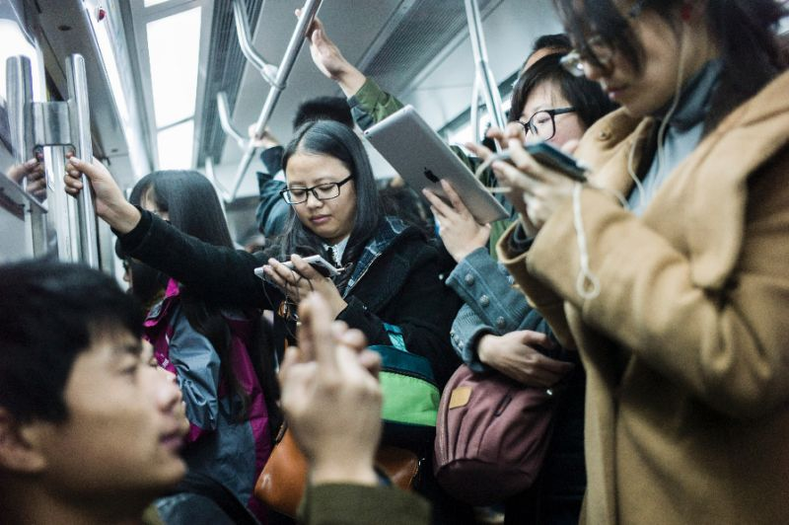
Scene 1
Montage of the evolution of computers
A transition of composition of computers and humans in the frame
The framing of all these people using technology, conveys to the audience how frequent we use technology and how much we rely on it
This section conveys have crucial it is for us and can help us
Use the famous physicist Neil DeGrasse Tyson

Slide 3
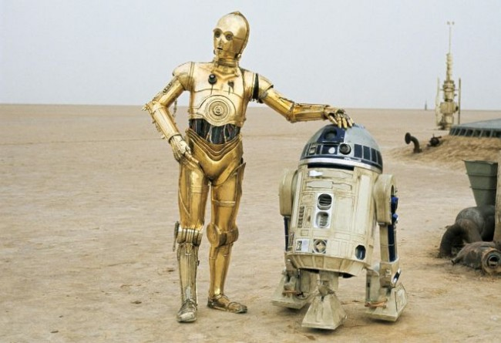
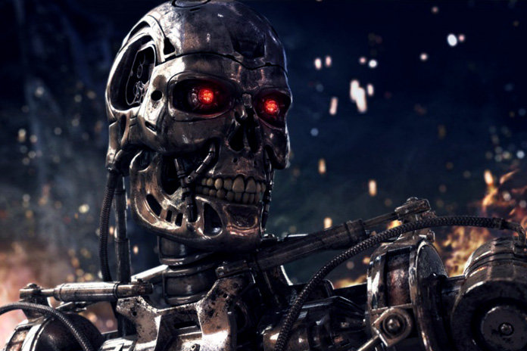
Use scenes from the Star Wars series, to allude to how humans and technology can be side by side with a mutualism relationship.
Its also interesting and relatable for our audience
This juxtaposes to scenes from the Terminator where technology takes over and is negative
Therefore alluding to the massive negative affect it can have

Slide 4
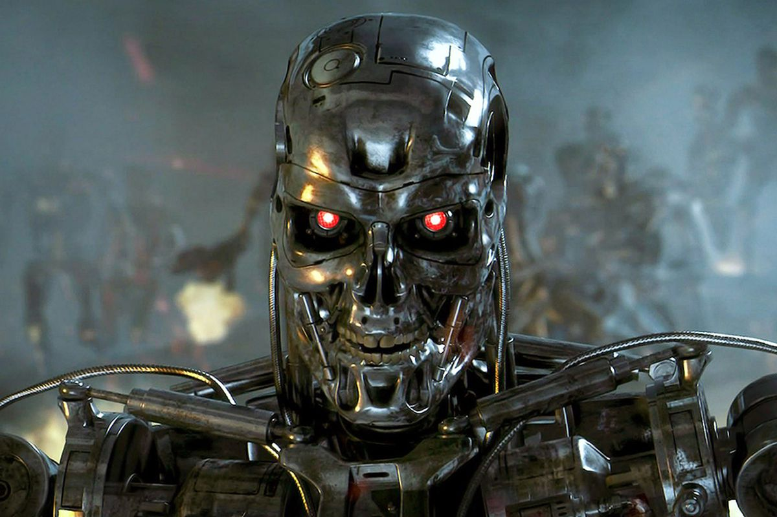
The last scene leaves us with a scene from “The Terminator” with a final quote being “It can’t be bargained with. It can’t be reasoned with. It doesn’t feel pity, or remorse, or fear.”
The scenes transition to black for 3-4 seconds of darkness.
Creates tension of mystery by leaving the audience in suspense
Title of doco pops up Automated world
Automated World

Slide 5
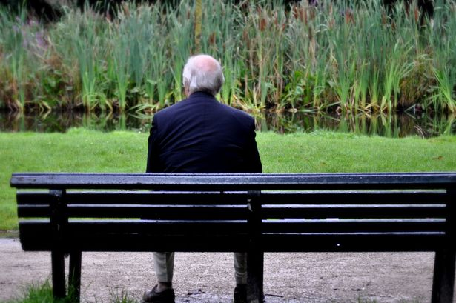
Scene 2
Starts with black with narration
Allows the audience to make their opinions
Introduction of Juan, someone affected by automation taking over the manufacturing business
The background of the scene juxtaposes the recent scene of technology
Causes the audience to focus on him rather than the background

Slide 6
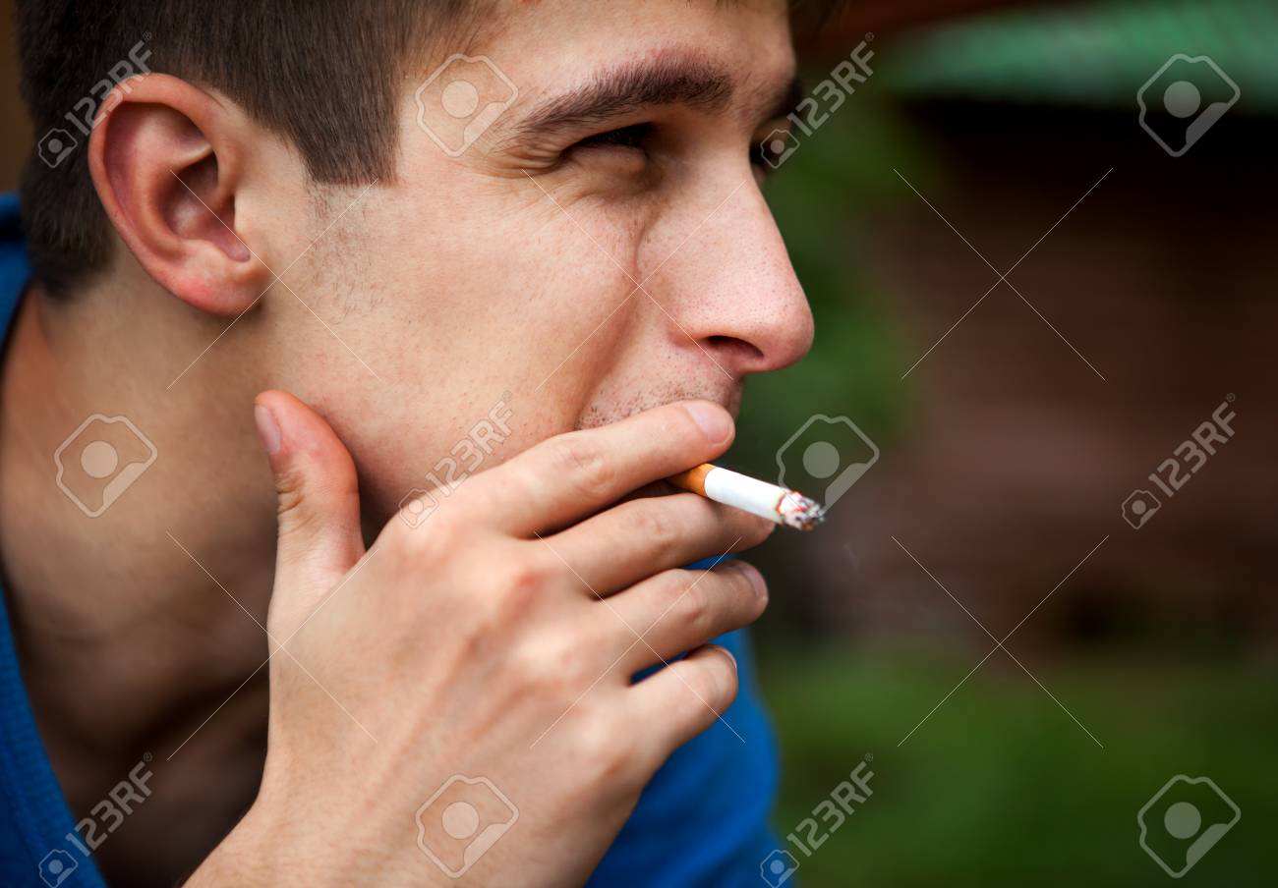
NOT SMOKING
Close up allows the audience to see his facial expression and how depressed he is
Even though he is Mexican, the audience will already their opinion
Him being Mexican can also create greater sympathy
Him being in the gives a firsthand experience of what it Is like
The condition of the car will highlight how he isn’t lazy

Slide 7
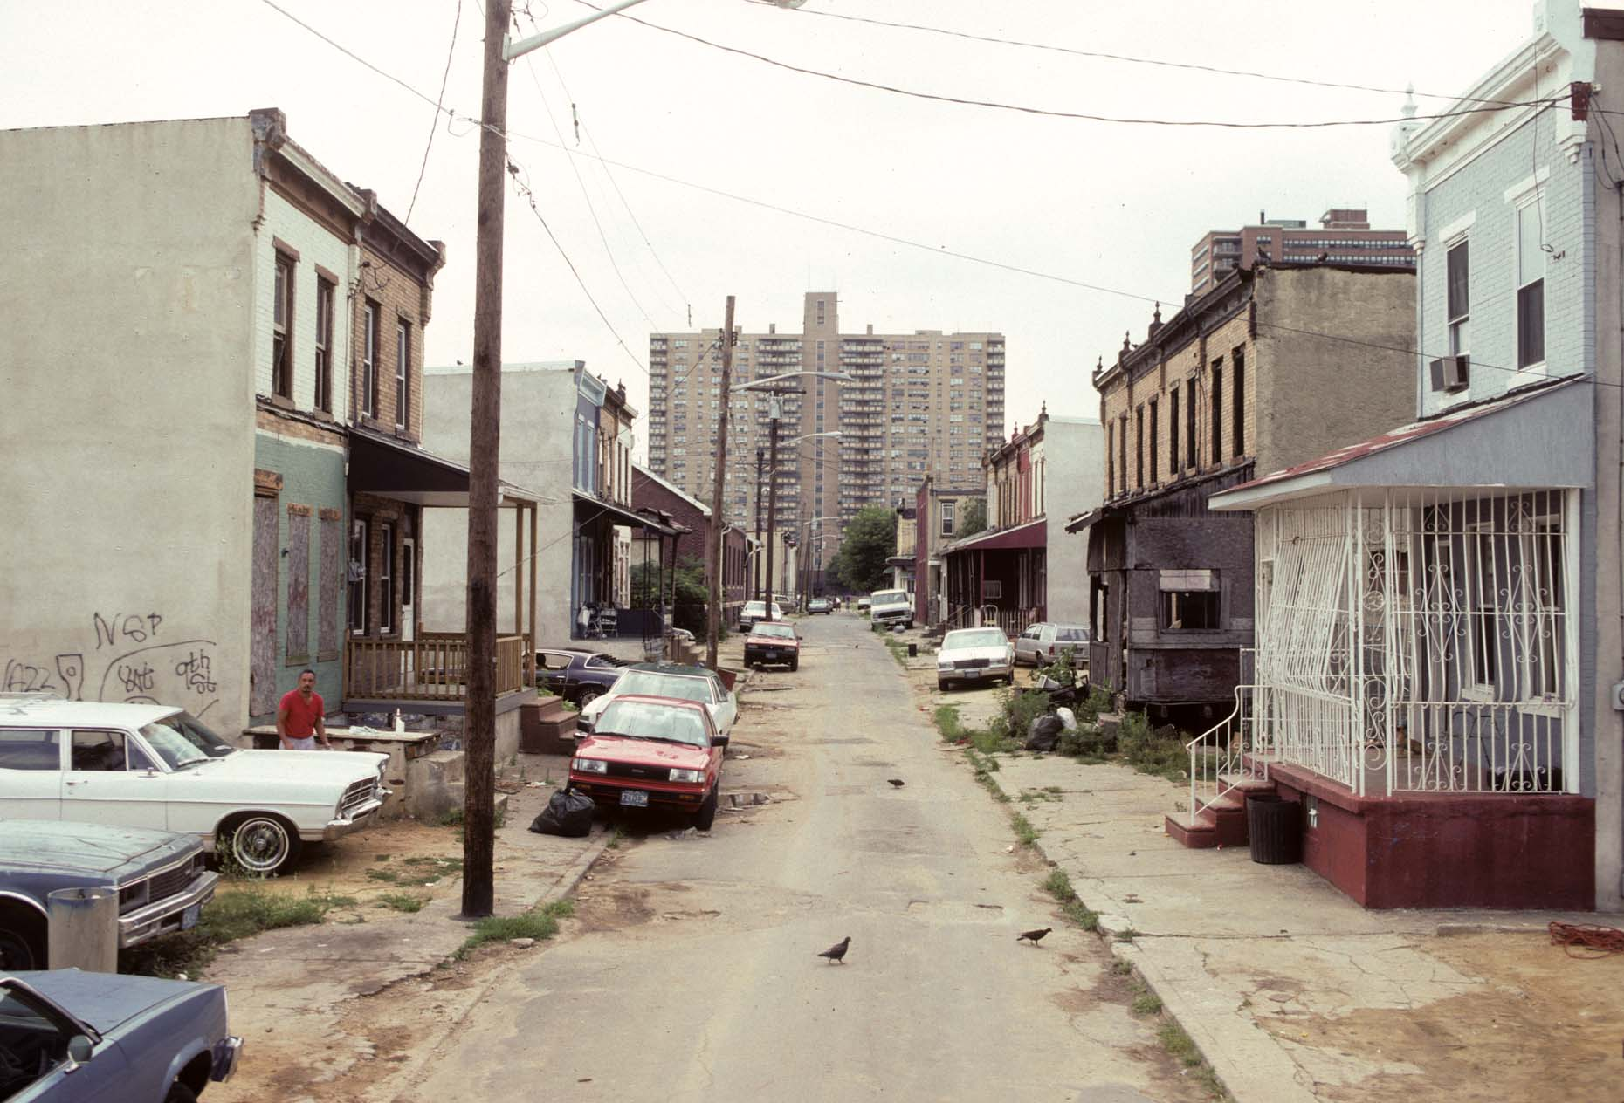
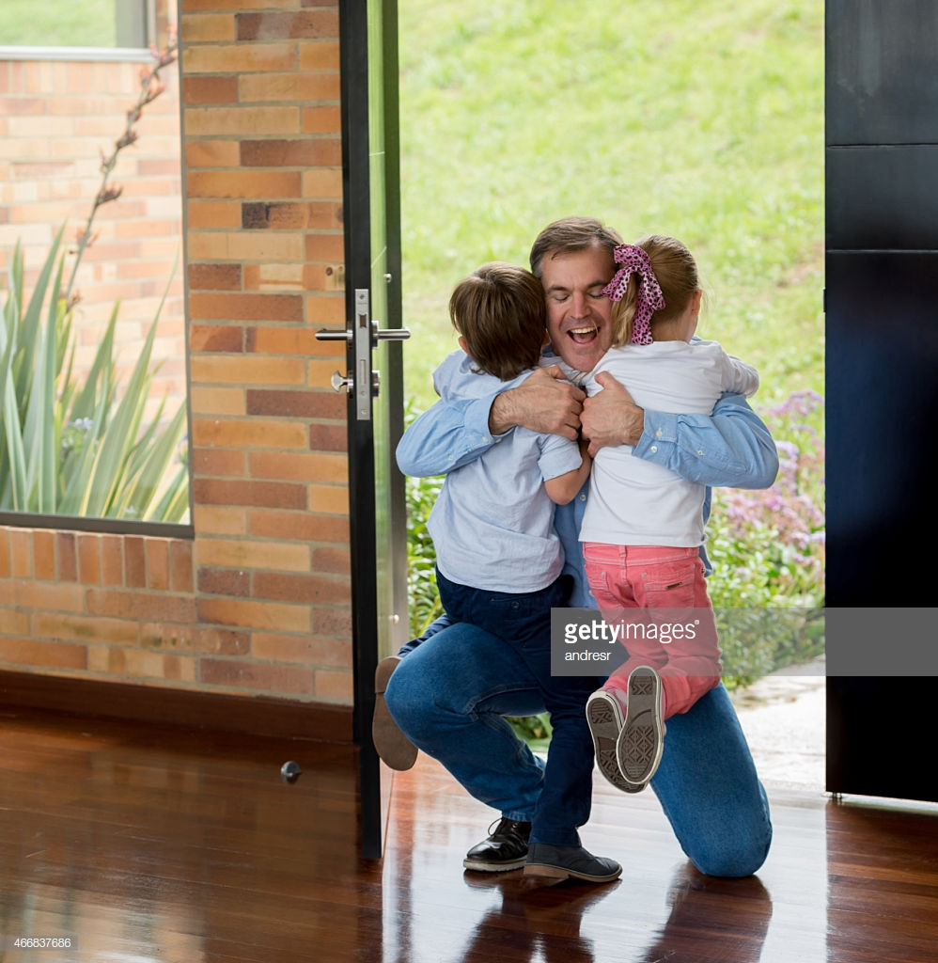
Long shot of the ghetto he lives in
Reinforces the struggle he is in after losing his job to automation
Which creates further sympathy
Tracking shot of him coming in to his family ( FROM BEHIND HIM)
Brings up family values from the audience

Slide 8
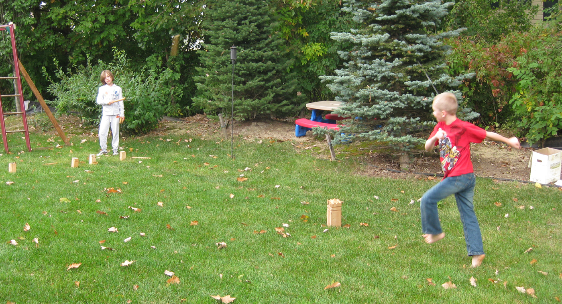
The irony of him using a computer while his job got taken over by automation
Him looking for a job reinforces his work ethic
The audience feels that they are with him while looking for a job and while he is watching his children
Clip of him talking about the struggle while watching his children
Furthers the family values
And introduces the issue of the cycle we talked about
The children in centre of frame, symbolising how they are the centre of his world

Slide 9
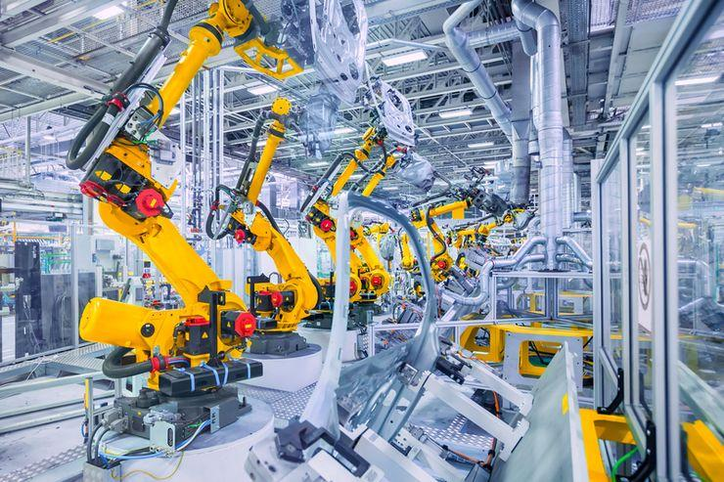
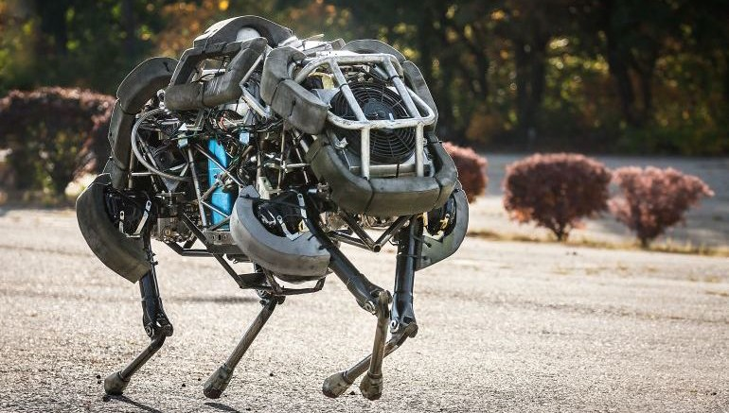
Closing Scene
Relates back to the intro
Narrator starts talking again
Montage of clips of technology in the world now
Low camera angle
Creates relevance
Illustrates some positives again
But it also depicts technology is engulfing our society, and even us

Slide 10
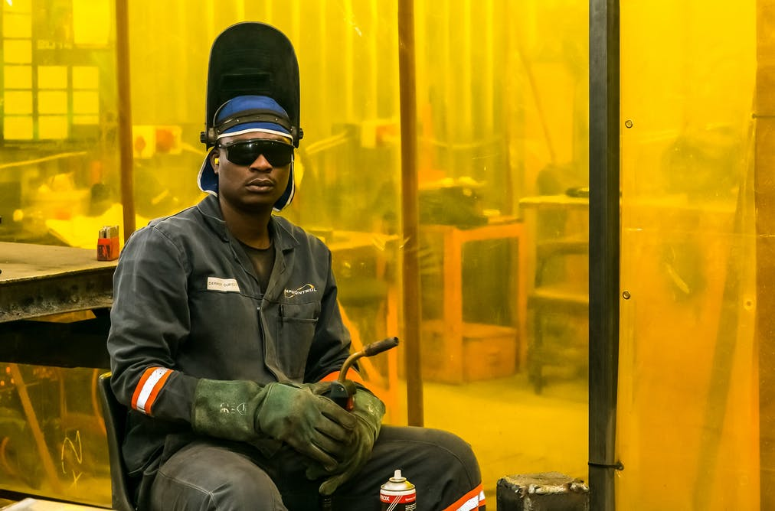
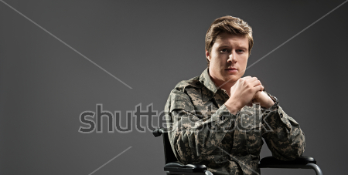
A montage of each of the individuals that told their accounts
High camera angle
Isolated
Gaze is straight at the camera
Creates an emotional response from the audience
And bring up each situation
It also gives time for the audience to reflect on how bad automation in the industry can be

Slide 11
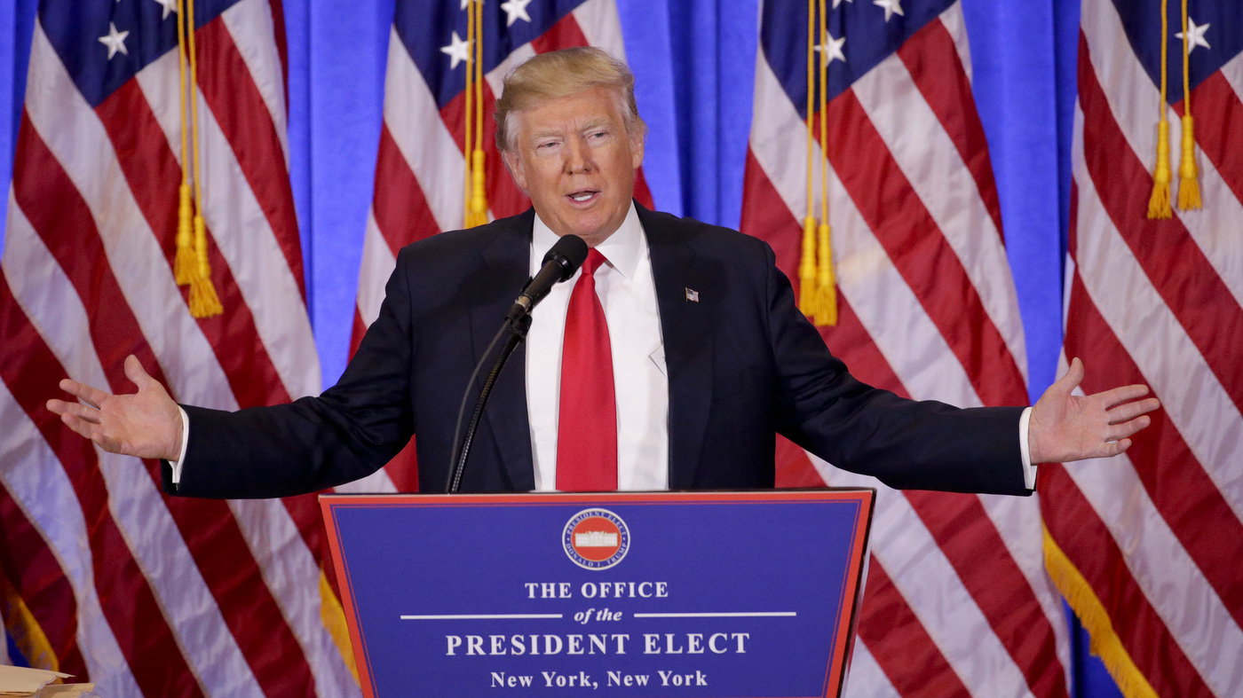
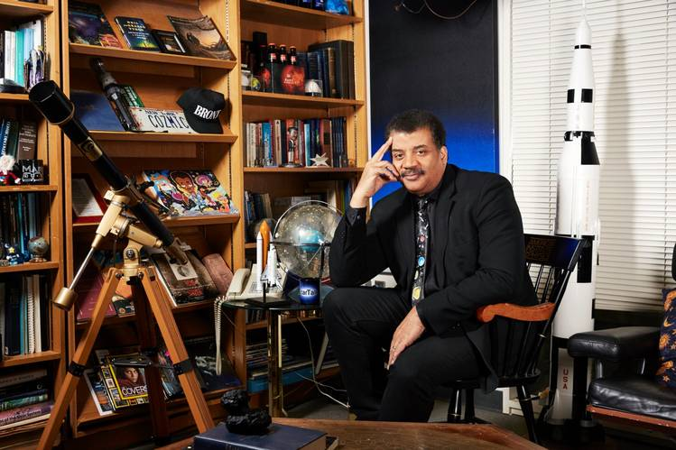
More shots of the victims
Transition to Donald Trump
Juxta poses with how many of the victims have lost their job
Neil DeGrasse Tyson in office with shallow depth of field
Causes the audience to focus on him
Makes it feel more personal and firsthand
Questions the job situation
47% of jobs will be wyped by 2020

Slide 12
What we left out

