Slide 2
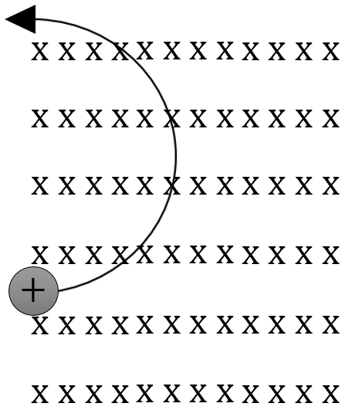
$$Electric field strength between$$
$$2 charged plates:$$
$$Magnetic field strength$$
$$produced by a current:$$
$$Force between 2$$
$$charged particles:$$
$$−$$
$$−$$
$$−$$
$$−$$
$$−$$
+
+
$$F=\frac{1}{4πε_{0}}\frac{q_{1}q_{2}}{r^{2}}$$
$$E=\frac{F}{q}=\frac{V}{m}$$
+
–
$$+$$
$$+$$
$$+$$
$$+$$
$$+$$
$$Deflection of a charged particle$$
$$in a magnetic field:$$
$$Force on a wire in a magnetic field:$$
$$B=\frac{µ_{0}I}{2πr}$$
$$S$$
$$\text{Induced} \text{emf} \text{across} \text{a} \text{straight}$$
$$\text{moving} \text{conductor}\text{:}$$
$$F=qvB_{⊥}$$
$$N$$
$$S$$
$$r=\frac{mv}{qB}$$
$$F=IlB_{⊥}$$
$$N$$
$$ε =lvB_{⊥}$$

Slide 3
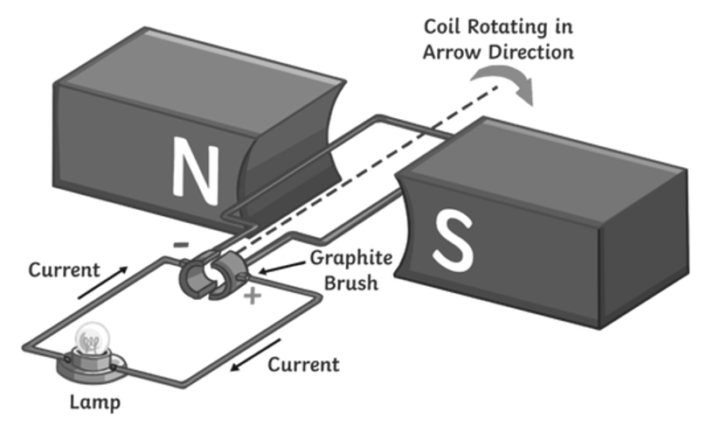
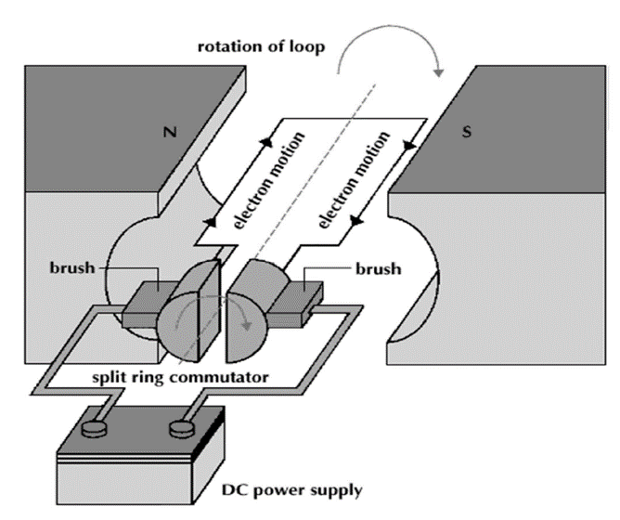
x
x
x
x
x
x
x
x
x
x
x
x
x
x
x
x
x
x
x
x
x
x
x
x
x
x
x
x
x
x
x
x
x
x
x
x
x
x
x
x
x
x
x
x
x
x
x
x
x
x
x
x
x
x
x
x
x
x
x
x
x
x
x
x
x
x
x
x
x
x
x
x
x
x
x
x
x
x
x
x
x
x
x
x
$$ε=−N\frac{ΔΦ}{t}=−N\frac{ΔBA_{⊥}}{t}$$
$$ε_{max}=2NlvB=2πNBA_{⊥}f$$
$$ε_{average}=−N\frac{ΔBA_{⊥}}{\frac{T}{4}}$$
$$τ=NAIB$$

Slide 4
N
S
When the stator is curved, at any point in time (except for when the armature is vertical) the direction of the magnetic field is parallel with the line connecting the current going to and from the split-ring commutator such that the force produced is always perpendicular to the armature, hence producing maximum torque.
N
S
N
S
N
S

Slide 5
Metal ion
Halogen
Solid metal
Halide ion
H⁺ ion
Solid metal

Slide 6
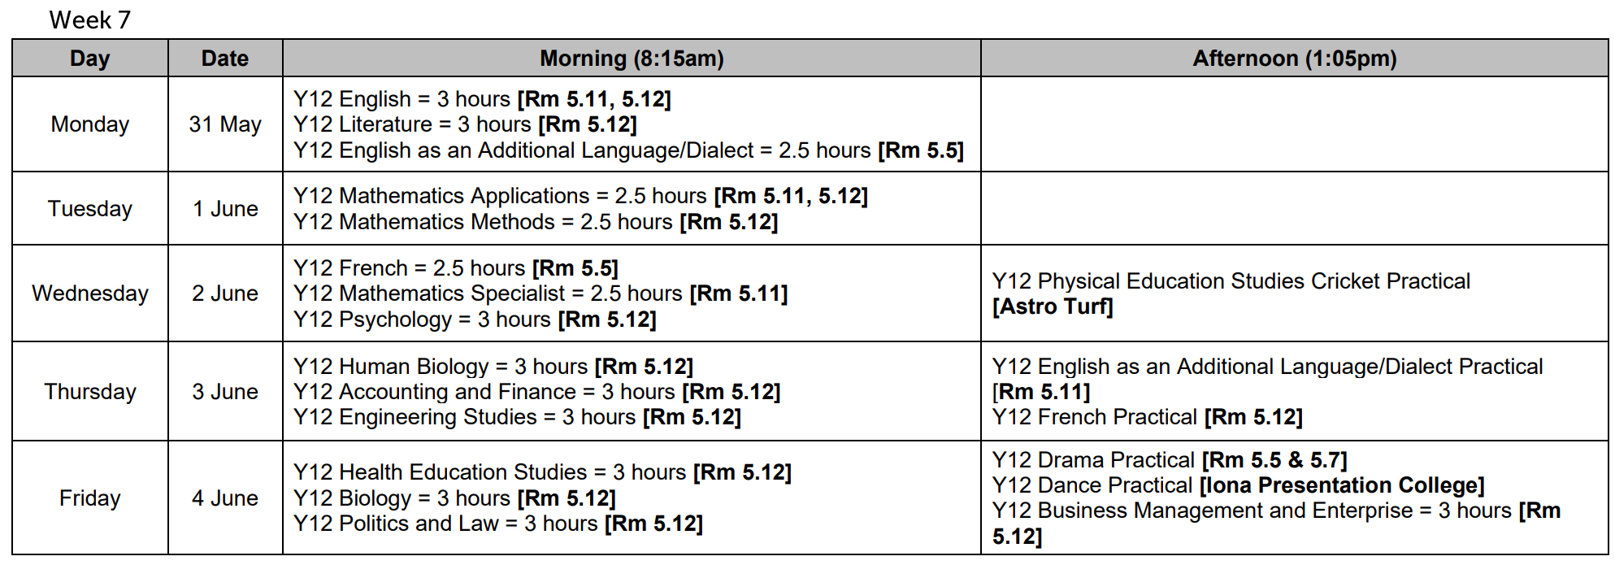

Slide 7
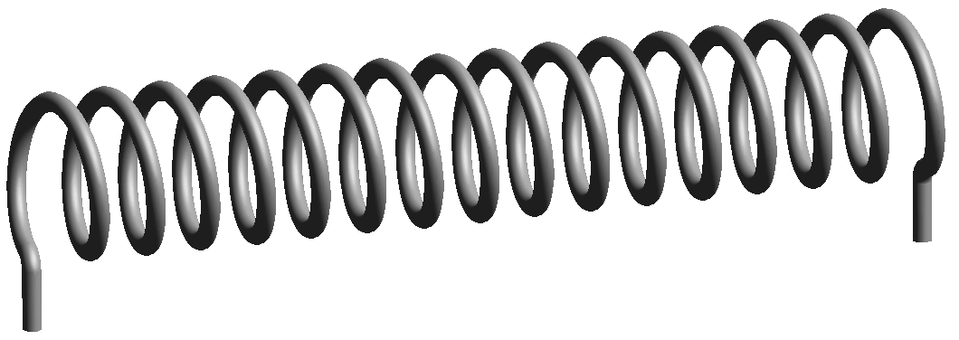
v
ΔB
B_{induction}
v
ΔB
B_{induction}

Slide 8
v
ΔB
B_{induction}
v
ΔB
B_{induction}

Slide 9
Reduced at a lower current → not in anode mud.
Reduced at a higher current → in anode mud.
Oxidised at a higher current → not in anode mud.
Oxidised at a lower current → in anode mud.

Slide 11
Free massage x1
Free massage x1
Free massage x1
Free massage x1
Free massage x1

Slide 12
White light
Angle of incidence
Angle of reflection
Angle of incidence = Angle of reflection
The greater the wavelength, the less it’s refracted.
Therefore red is refracted the least.
Angle of reflection
Angle of incidence
$$n_{1}\sin{θ_{1}}=n_{2}\sin{θ_{2}}$$

Slide 13
Are the benefits
greater than the
costs?
What is the problem
and its significance?
Is it amenable
to change?
Acceptability
What actions are
recommended?
No
Discontinue
Identify the problem
Target group
Epidemiology
Cost to community
Community perceptions
Unknown
Pilot
No
Unknown
Yes
Assess costs:
Social impact
Ethics
Economic
Efficacy
Pilot
Advocate
Develop interventions:
Policy
Education
Environmental
Yes
Implement
Acceptance by who?
Low levels of
acceptance?
High levels of actions?
Monitor

Slide 14
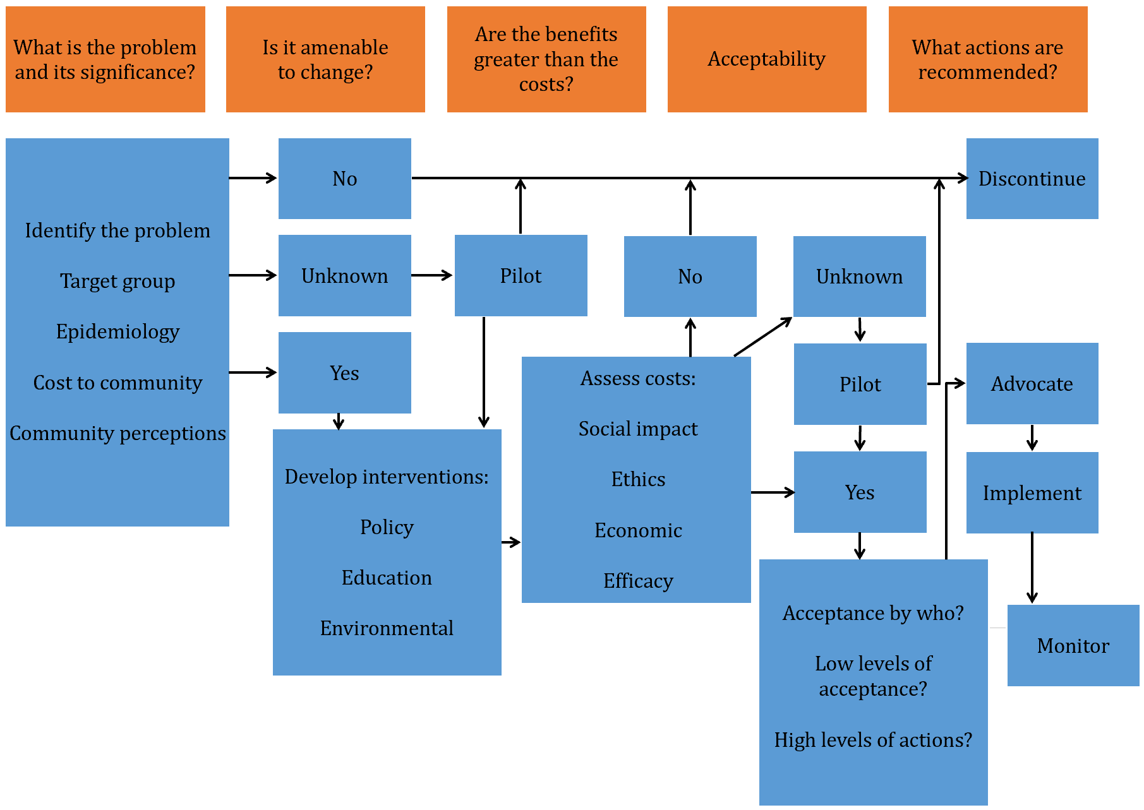

Slide 15
Action area No. 4: Strengthen global governance and collaboration.
International cooperation and solidarity is important for the equitable benefit of all people.
Multilateral organisations play an important role in:
Communicating norms and guidelines.
The identification of good practices that support actions
on the social determinants of health.
The facilitating of the access to financial resources and technical cooperation.
Reviewing and, when appropriate, strategically modifying
policies and practices that have a negative impact on a person’s health and wellbeing.
Action area No. 3:Further reorient the health
sector towards reducing health inequities.
Accessibility, availability, acceptability, affordability and quality
of healthcare and public health services are essential to the enjoyment
of the highest attainable standard of health.
They are one of the fundamental human rights of every human being
and the health sector should act to reduce health inequities
Action area No. 2: Promote participation
In policy making.
Empower and strengthen communities to
participate in decision-making procedures.
Promote inclusive and transparent decision-making.
Action area No. 1: Adopt better governance
for health and development.
Governance to address the social determinants
of health should involve:
Transparent and inclusive decision-making processes
that give voice to all groups and sectors involved.
Developing policies that perform effectively and
reach clear and measurable outcomes,
build accountability and involve fair policy
development processes and results.
Action area No. 5: Monitor progresses and increase accountability.
Monitoring trends in inequities and the impacts of actions to
tackle them is important to achieving meaningful progress.
Information systems should facilitate the establishment of relationships
between health outcomes and social organisation variables.
All accountability mechanisms to guide policy making in all sectors are
essential, taking into account different national contexts.
Rio Political Declaration on
Social Determinants of Health
Health inequities within and between countries are politically,
socially and economically unacceptable, unfair and largely avoidable.
The promotion of health equity is vital to move forward
and improve the equality of life and wellbeing for all.
Actions to address the social determinants for vulnerable groups and
the entire population is essential to create inclusive, equitable, economically
productive and healthy societies.
3 overarching recommendations:
To improve daily living conditions.
To tackle the inequitable distribution of power, money and resources.
Measure and understand the problem and assess the impact of action.

Slide 17
$$x$$
$$\text{t}\text{an}\text{θ}\text{=}\frac{x}{D}$$
$$\text{sin}\text{θ}\text{=}\frac{n\text{λ}}{d}$$
$$D$$
$$\text{t}\text{an}\text{θ}\text{≈}\text{sin}\text{θ}$$
$$\frac{x}{D}=\frac{n\text{λ}}{d}$$
$$x=\frac{n\text{λ}\text{D}}{d}$$
$$\text{n}\text{λ}$$
θ
θ
$$d$$

Slide 18
$$x$$
$$\text{t}\text{an}\text{θ}\text{=}\frac{x}{D}$$
$$\text{sin}\text{θ}\text{=}\frac{n\text{λ}}{d}$$
$$D$$
$$\text{t}\text{an}\text{θ}\text{≈}\text{sin}\text{θ}$$
$$\frac{x}{D}=\frac{n\text{λ}}{d}$$
$$x=\frac{n\text{λ}\text{D}}{d}$$
$$\text{n}\text{λ}$$
θ
θ
$$d$$

Slide 19
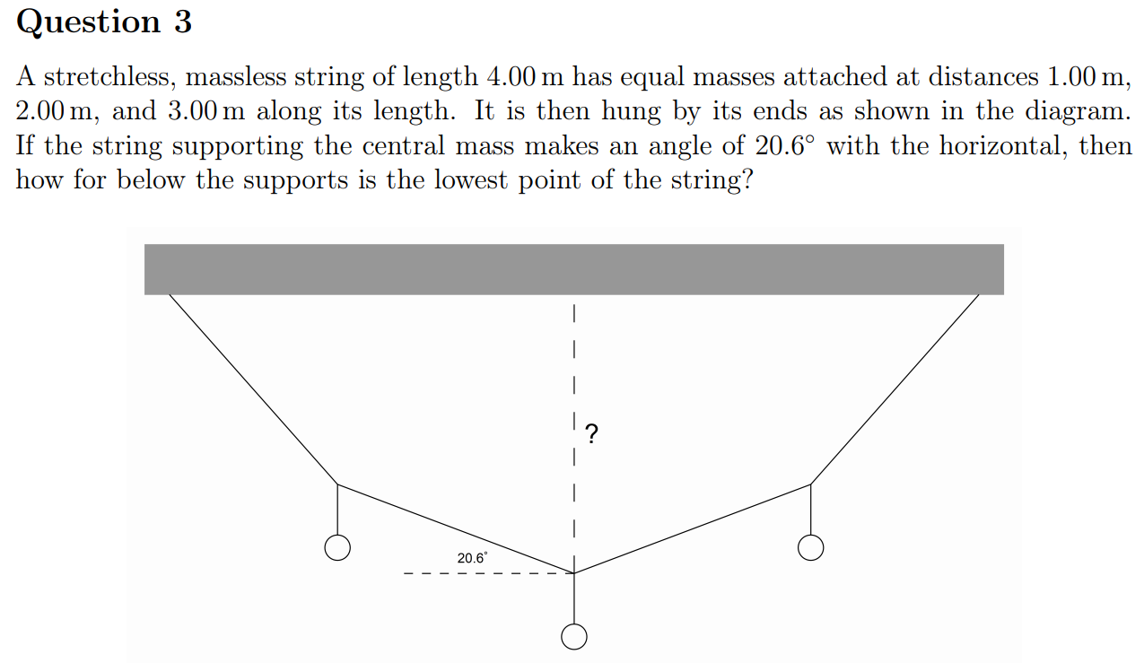
1m
1m
1m
1m
1m

Slide 20
Direction of propagation
Displacement (m)
Distance (m)
Direction of propagation
Displacement (m)
Time (s)

Slide 21
Step 1
Step 2
Step 3

Slide 22
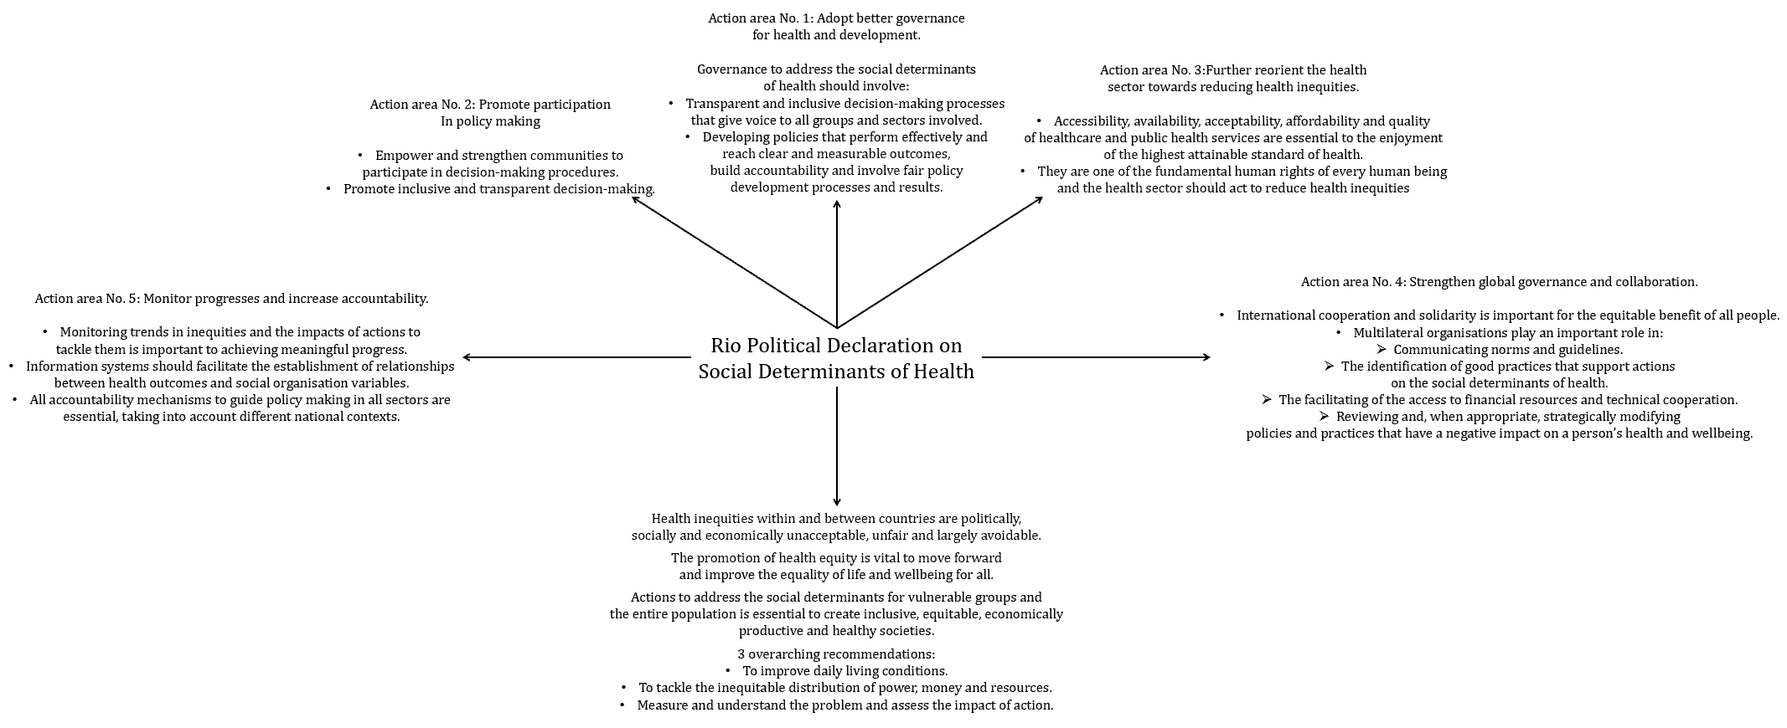

Slide 23
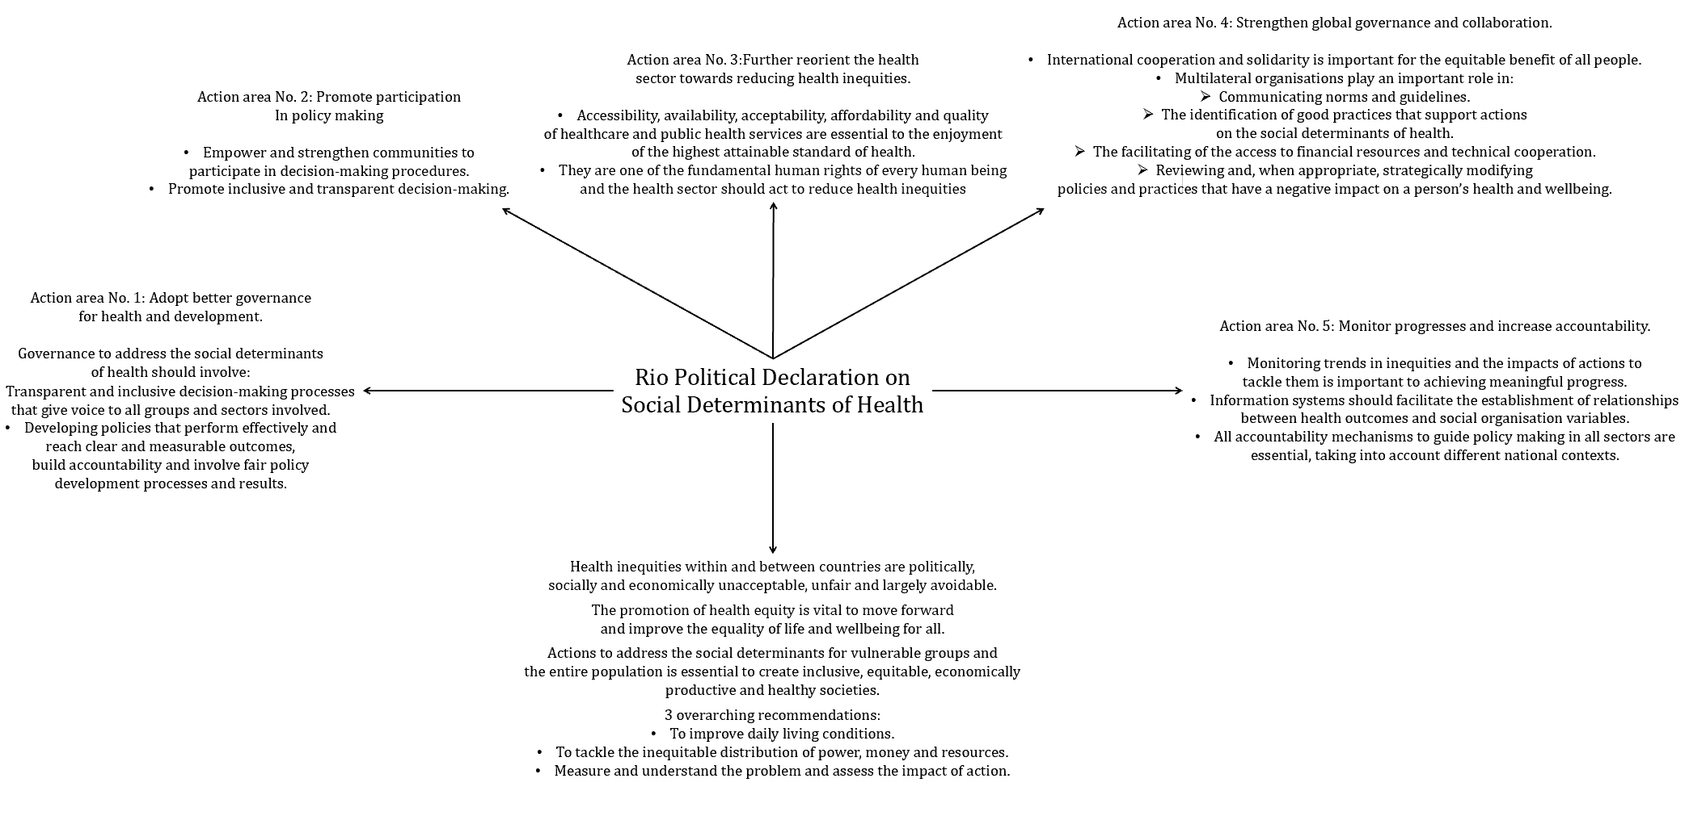

Slide 24
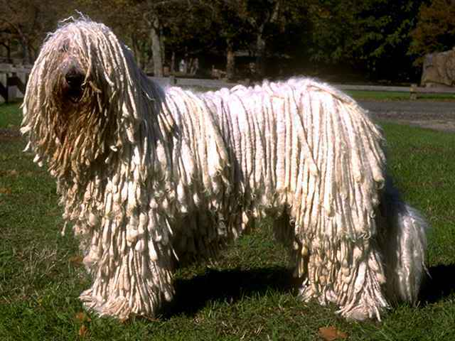
H U G S A D R A G D O G s
ealth literacy nemployment eographic location ocial isolation ccess and level of education islocation of land acism ccess to health services ender iscrimination ccupation overnment economic and social policies ocioeconomic status

Slide 25
Rio Declaration on Social Determinants of Health
Action areas:
Adopt better governance for health and development.
Promote participation in policy making and implementation.
Strengthen global governance and collaboration.
Further reorient the health sector towards reducing health inequities.
Monitor progress and increase accountability.

Slide 26
5 A’s of Access
Can
Vegan
Ducks
Fly
clap
Acceptability
Availability
Adaptability
Affordability
Accessibility

Slide 27
PABCAR model
P
A
B
C
A
R
Identification of the problem
Is the problem amenable to change?
Benefits and
Costs of implementing interventions
Acceptability of proposed measures
Recommended actions and monitoring

Slide 29
Skills that Support Positive Health Behaviours
Assertiveness
Stress management
Resilience
Improving Access to Healthcare
Improving access to healthcare.
Improving health literacy.
Ottawa Charter action areas.

Slide 30
Ottawa Charter for Health Promotion
Enabling
Mediation
Advocacy
Ottawa Charter Action Areas
Build healthy public policy
Develop personal skills
Reorient health services
Strengthen community action
Create supportive environments

Slide 31
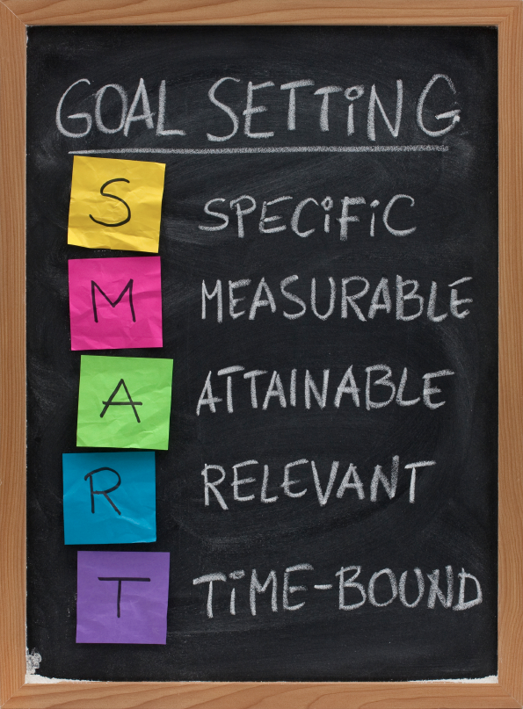
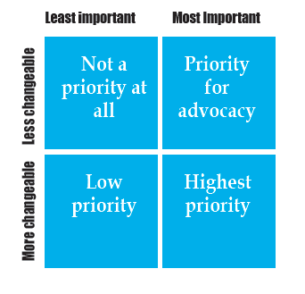
Needs Assessment
Steps:
Identification of the problem
Analysis of the problem
Prioritising issues
Setting goals
Determining strategies
Developing action plans
Evaluating outcomes
I
Am
Probably
Super
Depressed
Don’t
even

Slide 32
Types of need
Normative
Comparative
Felt
Expressed
Characteristics of a Self-Actualised Person
Peak experiences
Realistic
Autonomous
Self-acceptance
Problem-centred
Spontaneous

Slide 33
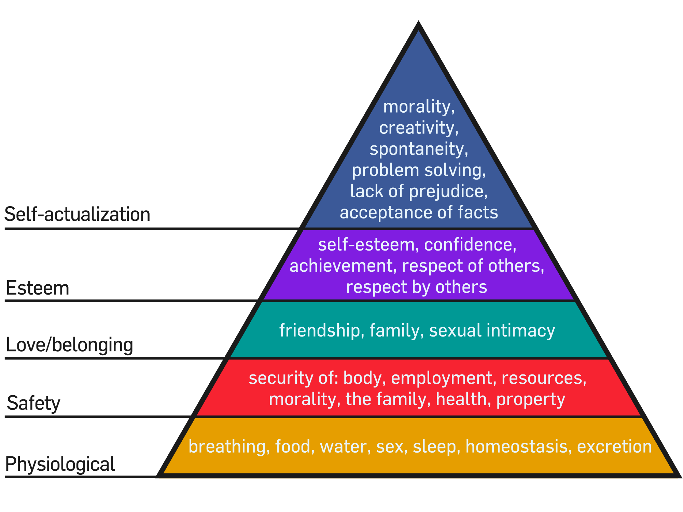
Social Justice Principles
Access and equity
Diversity
Supportive environments
Maslow’s Hierarchy of Needs
Physiological
Safety
Social
Esteem
Self-actualisation

Slide 34
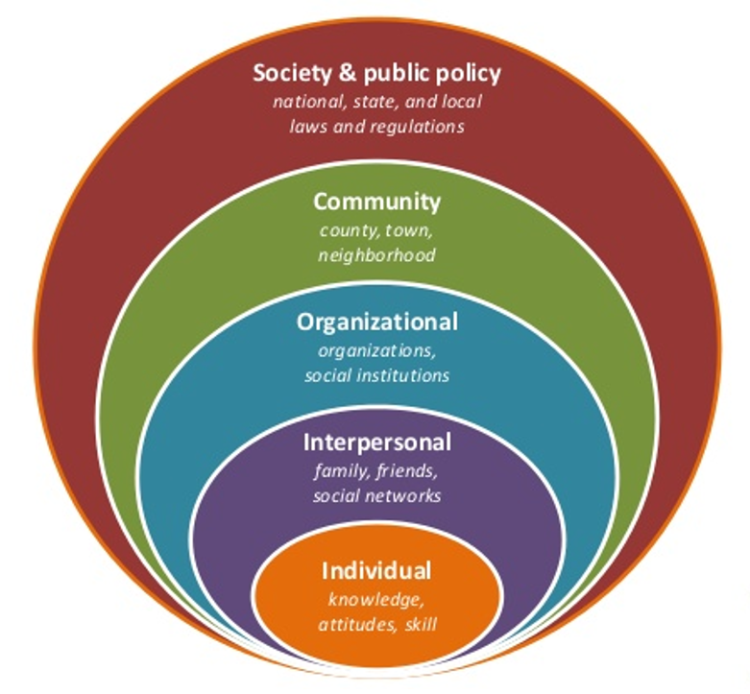
Socioecological Model of Health
Levels:
Individual
Interpersonal
Organisation
Community
Societal
Idiotic
Imagination
Overpowers
Communal
spaghetti

Slide 35
Factors that Create Health Inequities
Socioecological Model of Health
Levels:
Individual
Interpersonal
Organisation
Community
Societal
H U G S A D R A G D O G s
ealth literacy nemployment eographic location ocial isolation ccess and level of education islocation of land acism ccess to health services ender iscrimination ccupation overnment economic and social policies ocioeconomic status
Idiotic
Imagination
Overpowers
Communal
spaghetti
Maslow’s Hierarchy of Needs
Physiological
Safety
Social
Esteem
Self-actualisation

Slide 36
Types of need
Normative
Comparative
Felt
Expressed
Characteristics of a Self-Actualised Person
Peak experiences
Realistic
Autonomous
Self-acceptance
Problem-centred
Spontaneous
Needs Assessment
Steps:
Identification of the problem
Analysis of the problem
Prioritising issues
Setting goals
Determining strategies
Developing action plans
Evaluating outcomes
I
Am
Probably
Super
Depressed
Don’t
even

Slide 37
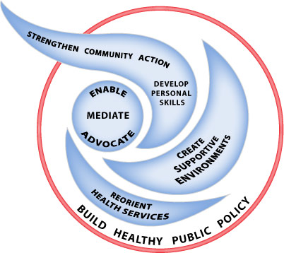
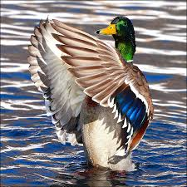
Ottawa Charter for Health Promotion
Enabling
Mediation
Advocacy
5 A’s of Access
Can
Vegan
Ducks
Fly
clap
Acceptability
Availability
Adaptability
Affordability
Accessibility
Ottawa Charter Action Areas
Build healthy public policy
Develop personal skills
Reorient health services
Strengthen community action
Create supportive environments
Skills that Support Positive Health Behaviours
Assertiveness
Stress management
Resilience
Improving Access to Healthcare
Improving access to healthcare.
Improving health literacy.
Ottawa Charter action areas.

Slide 38
PABCAR model
P
A
B
C
A
R
Identification of the problem
Is the problem amenable to change?
Benefits and
Costs of implementing interventions
Acceptability of proposed measures
Recommended actions and monitoring

Slide 39
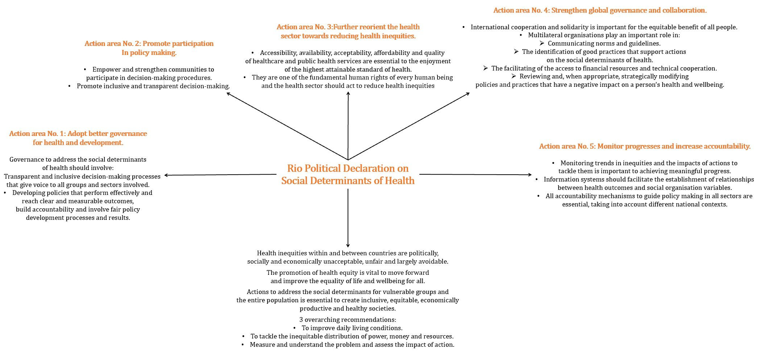

Slide 40
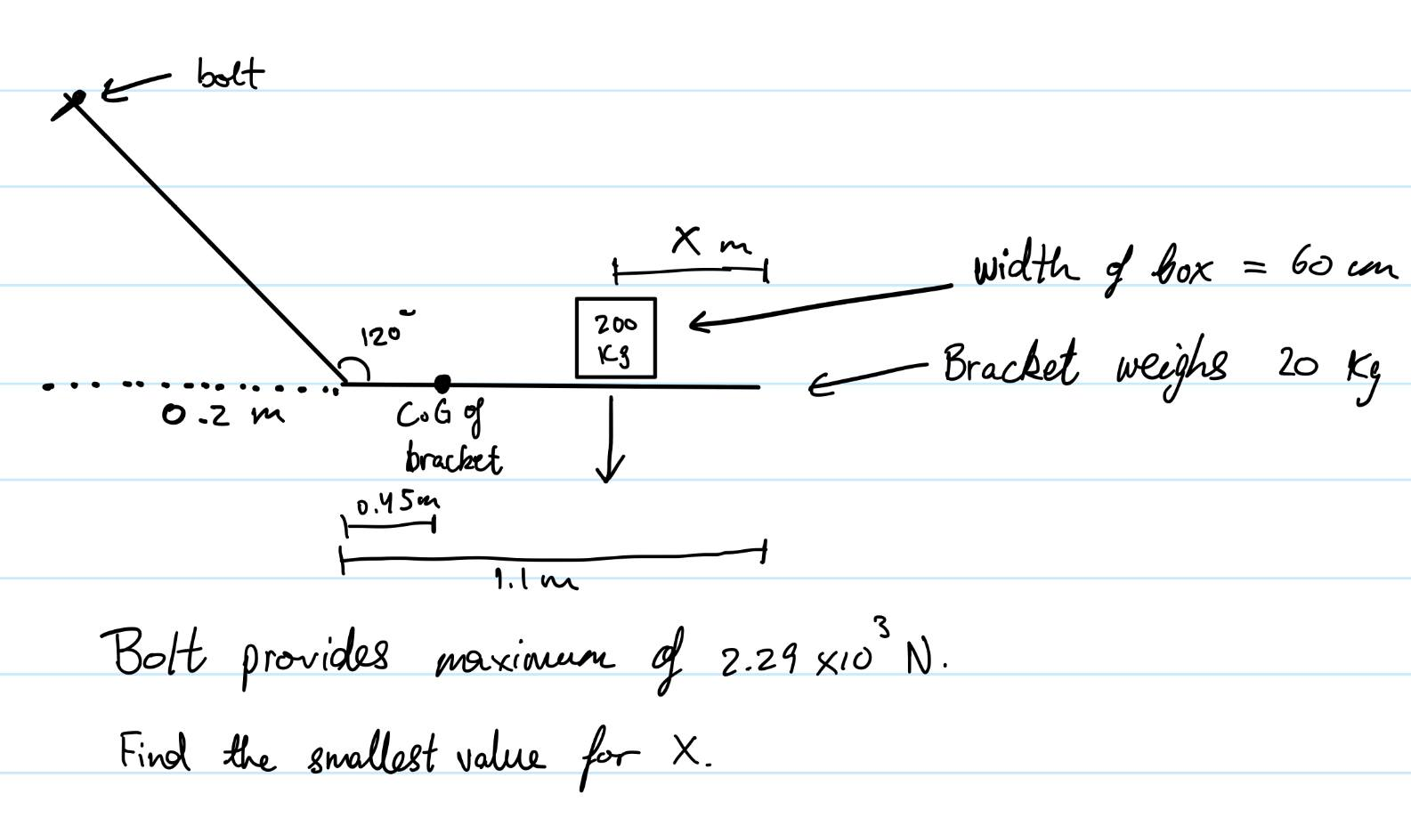
Bolt
Width of box = 60cm
Bracket weighs 20kg
X m
Centre of mass of the bracket
200kg
120º
0.2m
0.45m
9.1m

Slide 41
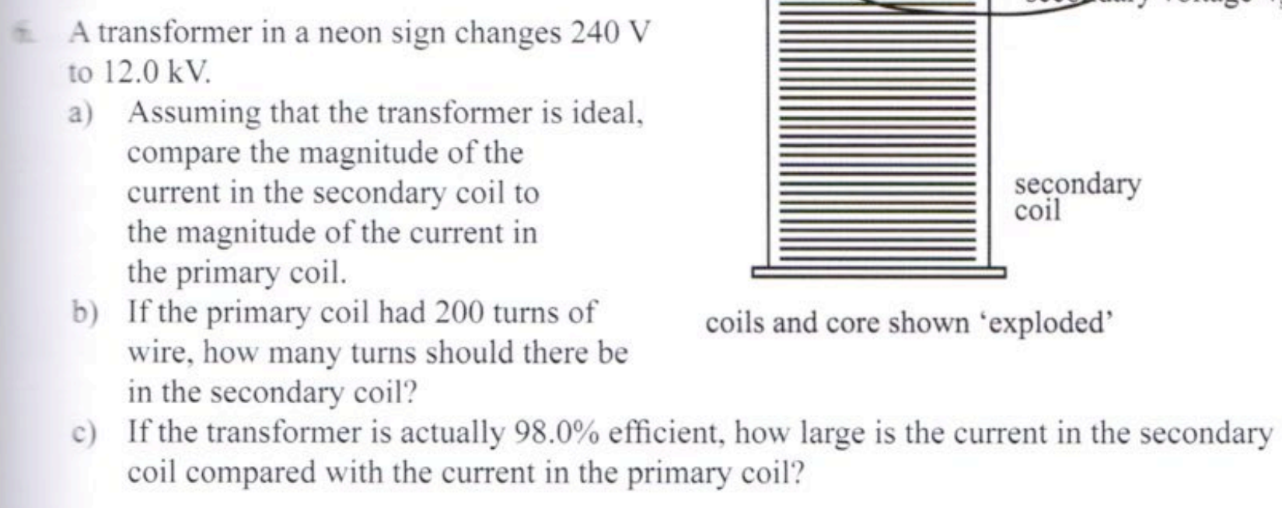

Slide 42
v

Slide 43
$$\frac{\sqrt{3}}{6}$$
$$−\sqrt{3}$$
$$\sqrt{3}$$

Slide 44
Artwork - Line drawing contrasting industry (symbolised by the LNG ship) with the
environment (symbolised by the marine animals) drawn below the ship.
Pollution is symbolised by the smoke surrounding the ship. The animals are placed
close to each other with the ship right on top to show how crowded the marine environment
has become.
Descriptive language, anthropomorphism - makes the whale seem
kind, mild - human qualities - makes the whale attractive and desirable.
Target audience - Value protection of environment as of highest importance.
Appeals to values of the environment.
Warns against complacency - tone.
Diction - Power imposed on choice = limited options - only 2 options are presented,
positioning the audience to view this as an either/or situation where options are mutually
exclusive. Structure and diction present a false dichotomy.
Connotations - overly enthusiastic.
Diction of protection - Saving, protected, safe, safer, saved, sparing, etc.
Repetition of "isn't" - warns.
Emotive language shows this is happening without us knowing.

Slide 45
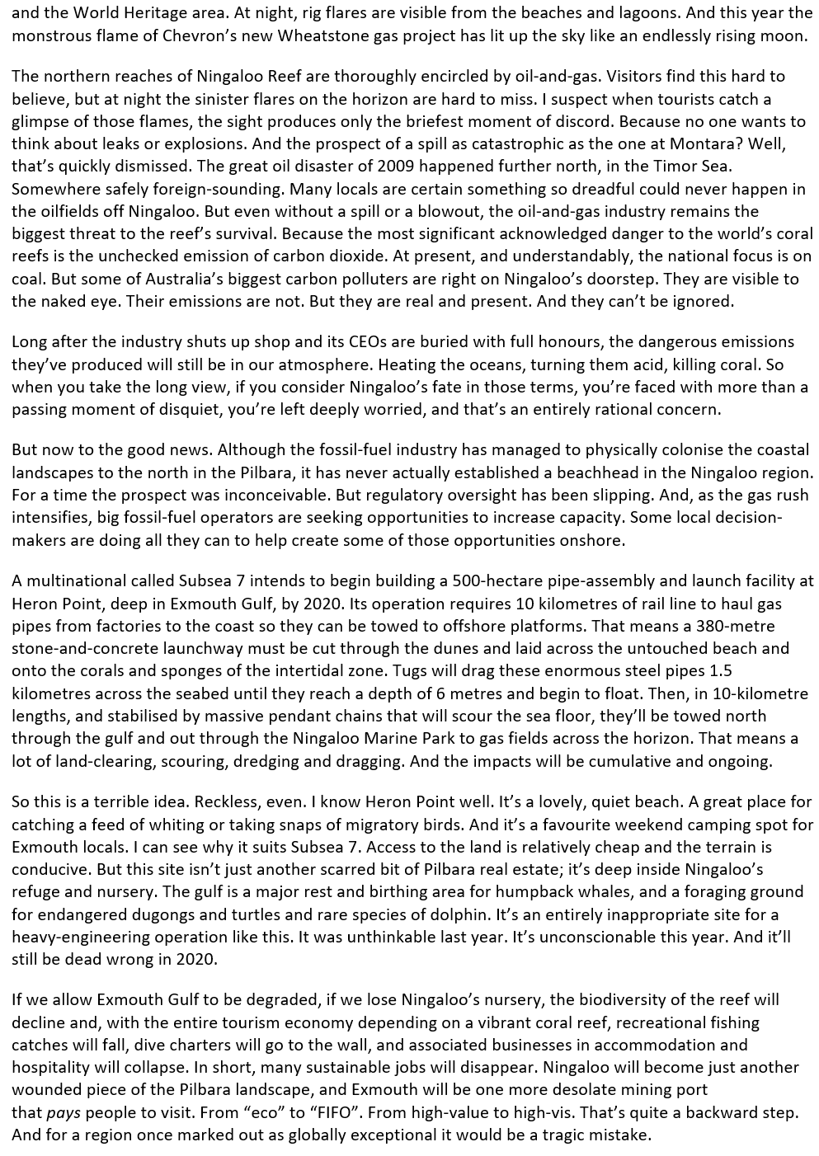
Adjective: Frightening, ugly, evil.
Simile - Unnatural.
Adjective: Harmful, threat, scary.
Adjective: Extremely serious, troubling, dangerous.
Repetition - Possibility of harm.
List of 3 - Unwanted effects of emission - destruction of the environment.
Emotive language - Feeling uneasy, anxious, upset, distressed, etc.
Imagery of the marine environment - Pristine is important for
species, untouched, place to appreciate and observe.
Verbs - Removing, abrasive, destroy, change, force.
List of 3 adjectives - short, imperative sentences - strong statements - no one
could support such damage to the environment, not morally acceptable, unethical.

Slide 46
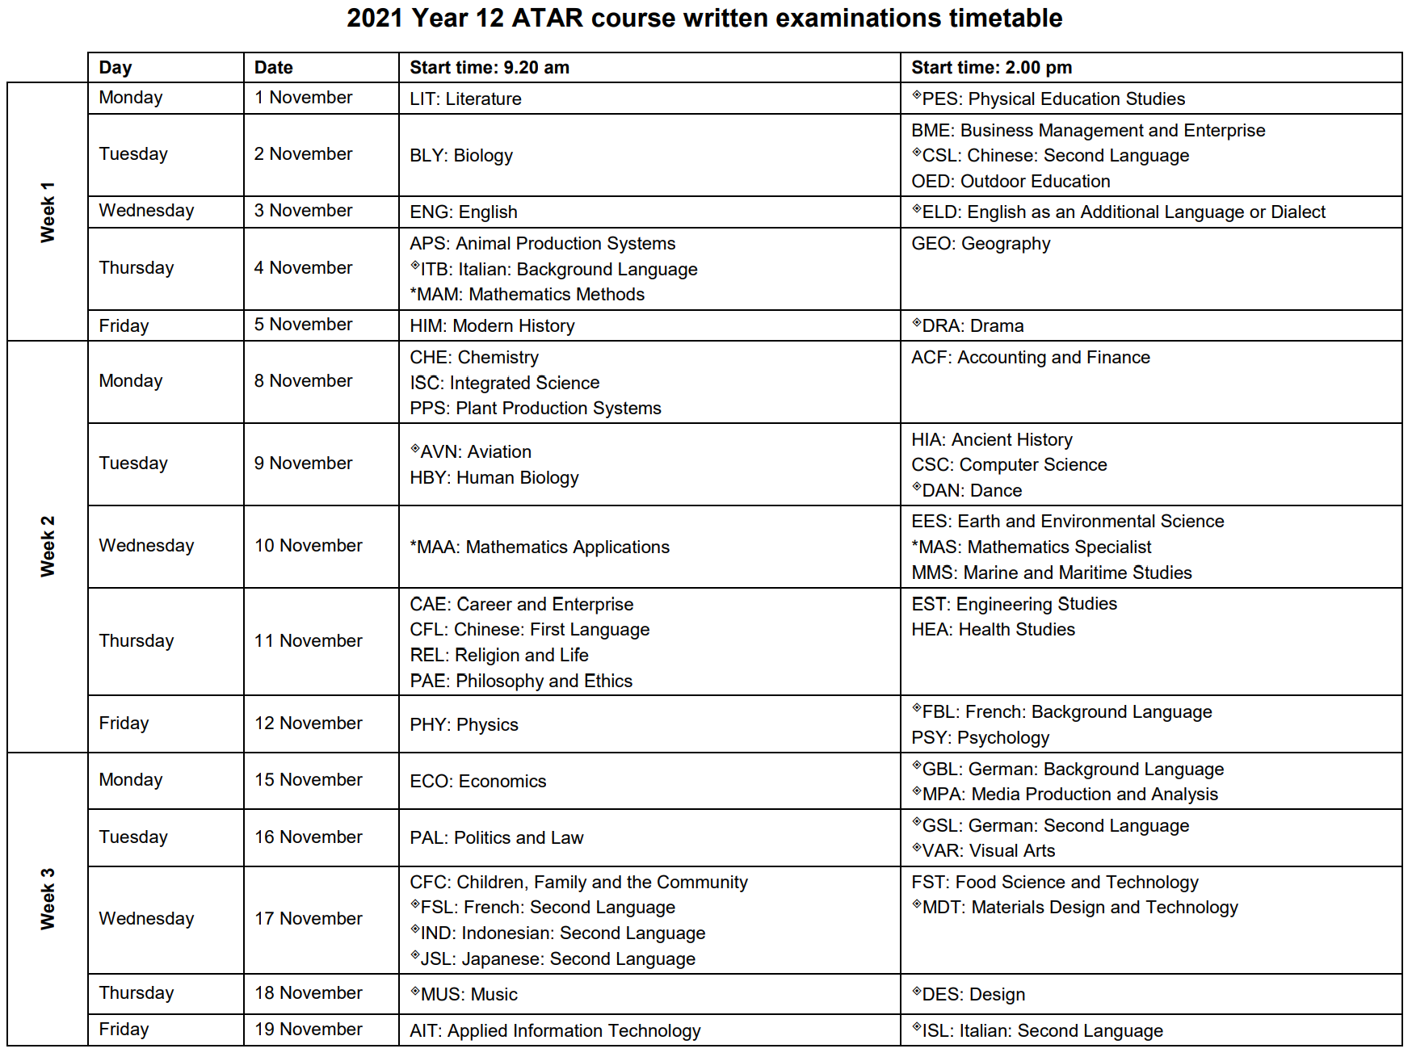

Slide 47
Hypothalamus
Releasing or inhibitory factors
Nerve fibres
Infundibulum
Blood
stream
Anterior lobe of pituitary:
Produces own hormones.
Connected via blood vessels.
Releases 6 hormones: GH, TSH, ACTH, PRL, LH and FSH.
Posterior lobe of pituitary:
Hormones produced by hypothalamus.
Release stimulated by nervous conduction.
Stores and releases 2 hormones: ADH and OT.

Slide 48
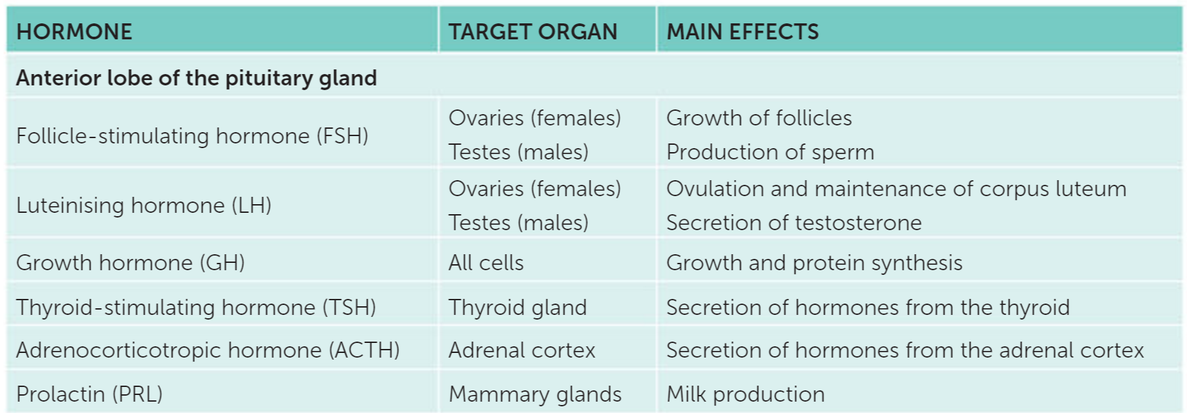

Slide 49
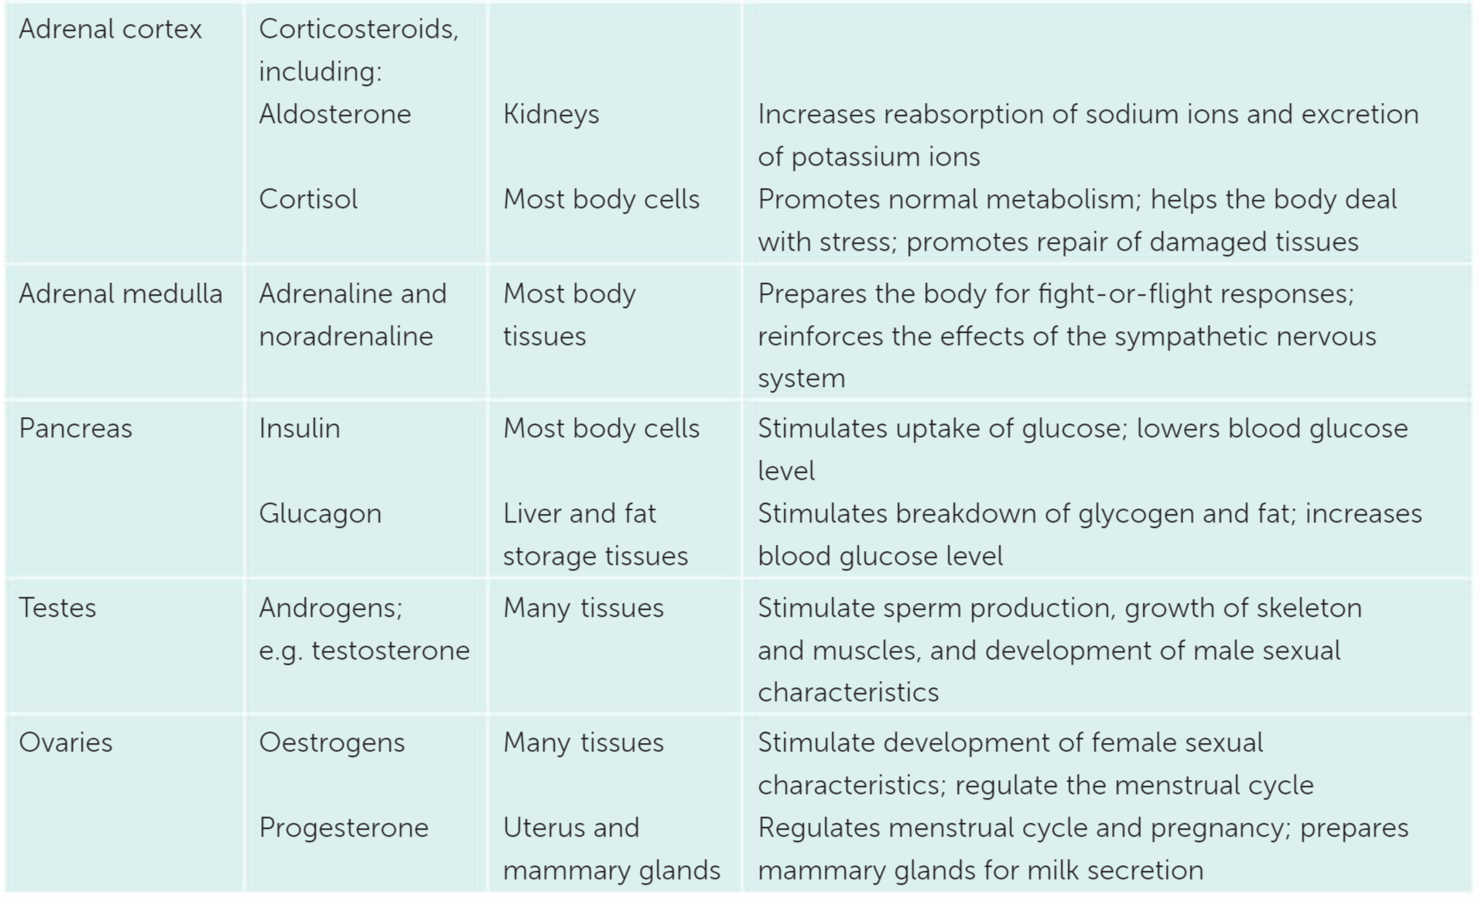

Slide 50
Tangent at x=x₀
Tangent at x=x₁
Tangent at x=x₂
Tangent at x=x₃
f(x₀)
f(x₁)
f(x₂)
f(x₃)
x₃
x₂
x₁
x₀
Integral starting value

Slide 51
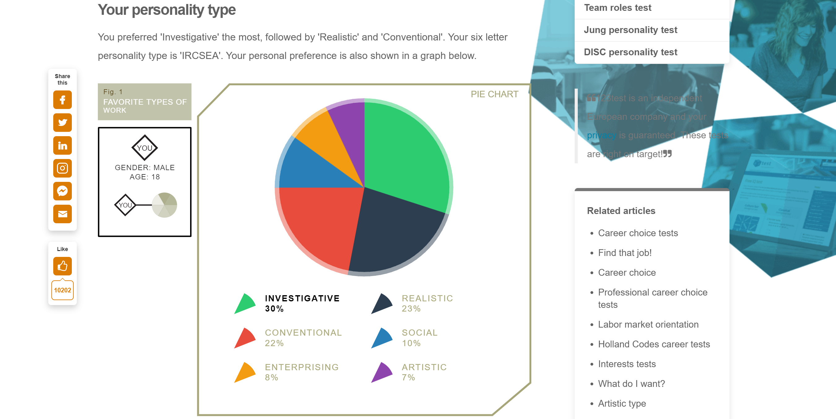

Slide 52
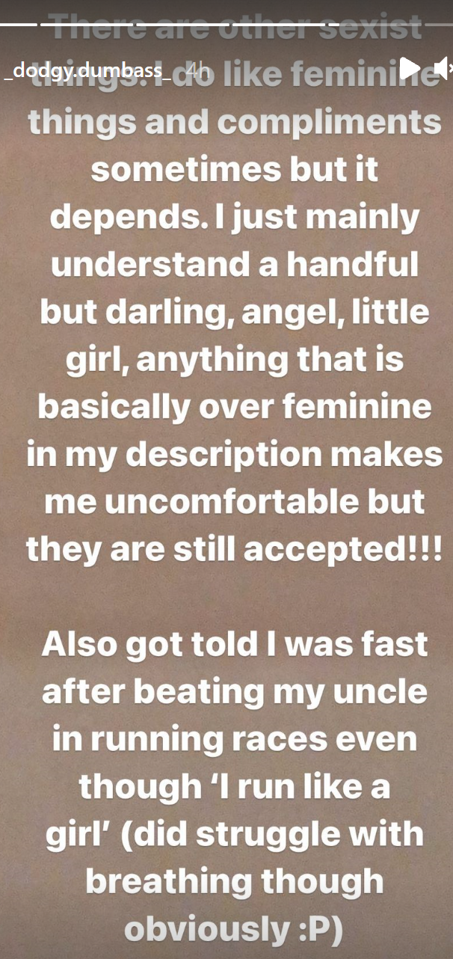
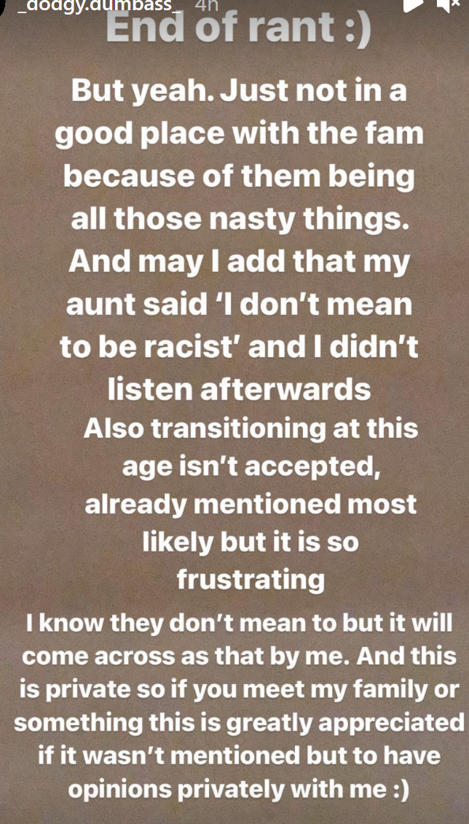

Slide 53
y
y=f(t)
t
a
δx
x

Slide 54
y
y=f(t)
t
a
δx
x

Slide 55
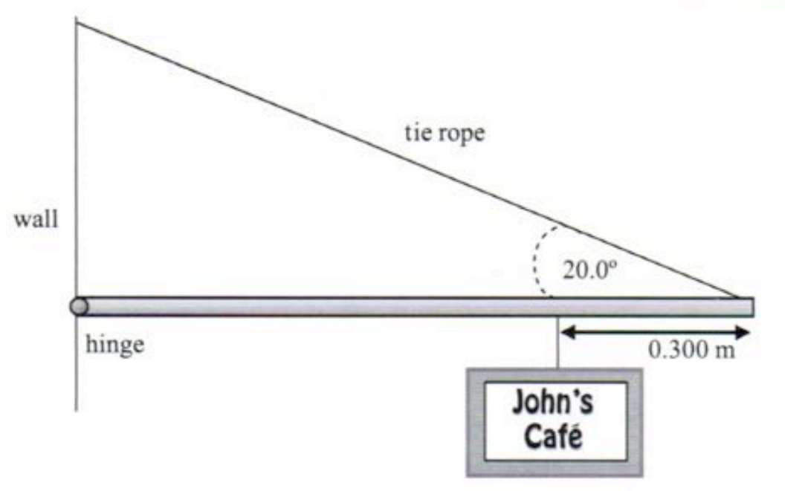
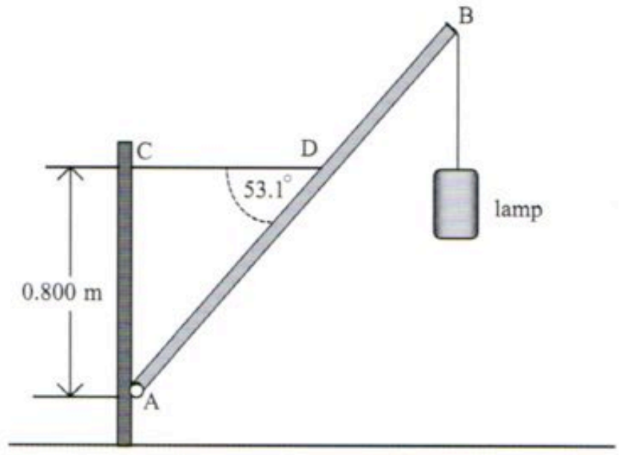
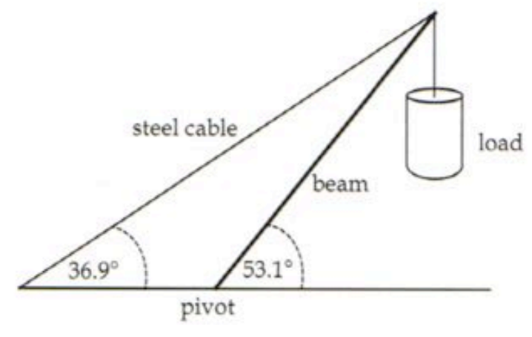
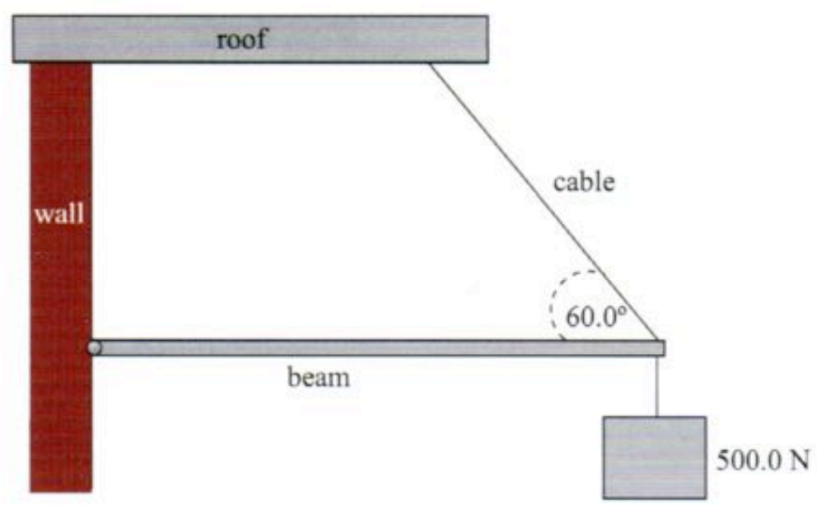
R
T
W
R
T
T
R
W
W
R

Slide 56
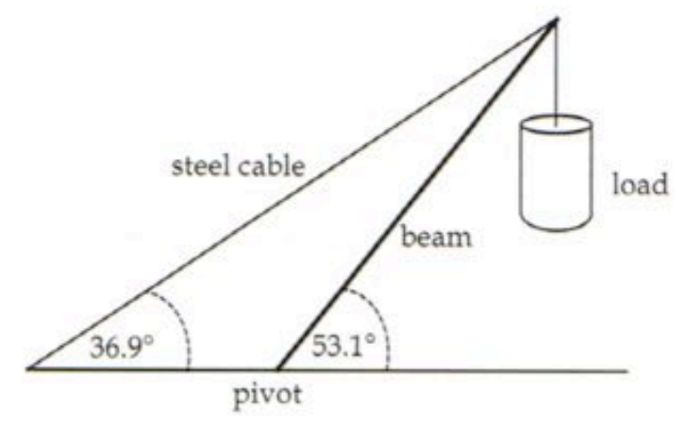
1. Find T
2.
W
–R
T
3. Solve for –R
4. State negative sign means reverse direction
5.
R
R_{v}
θ
R_{h}
6. R_{h} = T, solve for R_{v}
7. Find θ

Slide 57
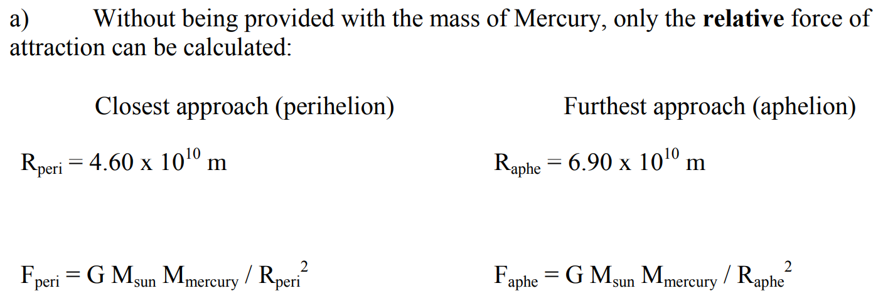
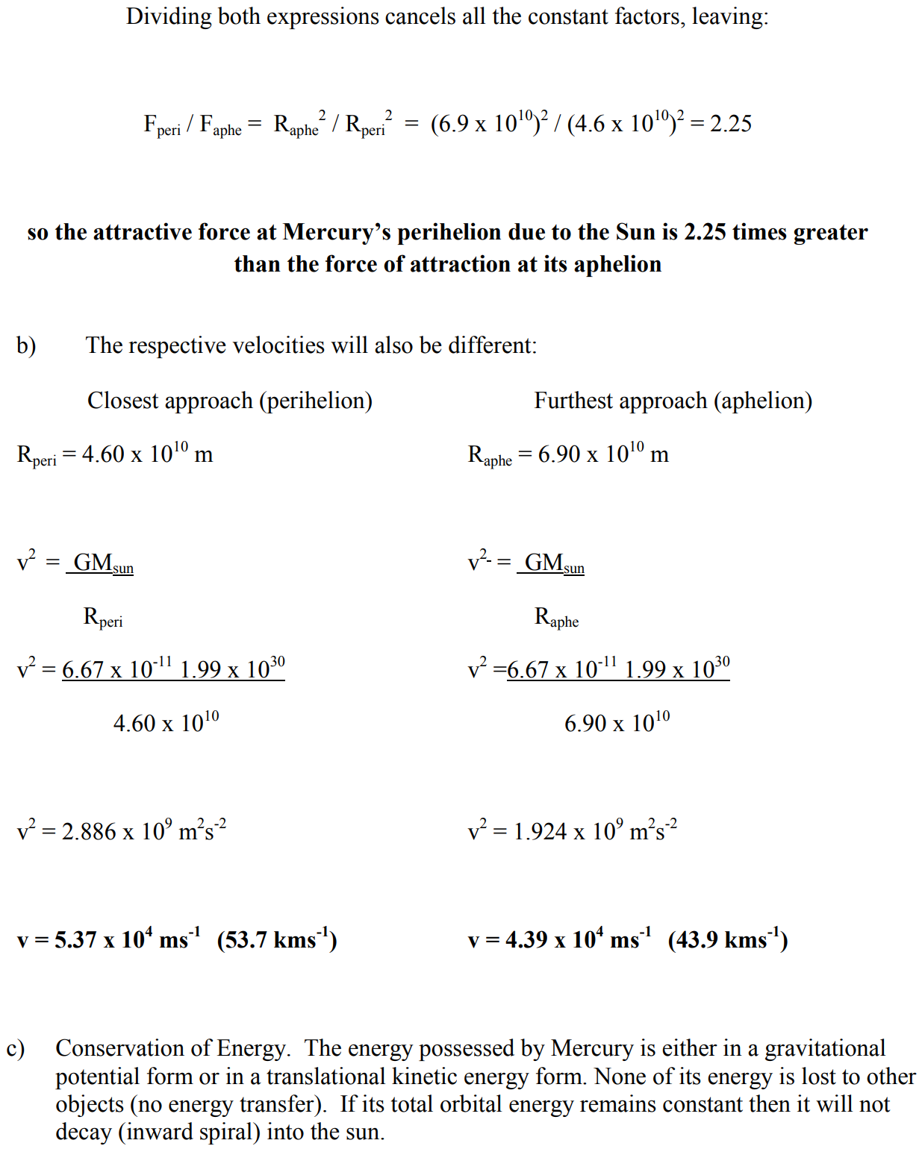

Slide 58
H₂COOC(CH₂)₁₆CH₃
HCOOC(CH₂)₁₆CH₃
H₂COOC(CH₂)₁₆CH₃

Slide 59
x₀=0:
1
0.75
-0.08725
1.00031
0.750387
-0.08257
1.000248
0.75031
-0.0835
1.000259
0.750324
-0.08333
1.000257
0.750321
-0.08336
1.000258
0.750322
-0.08336
1.000258
0.750322
-0.08336
1.000258
0.750322
-0.08336
1.000258
0.750322
-0.08336
1.000258
0.750322
-0.08336
1.000258
0.750322
-0.08336
x₀=1:
0.75
-0.08725
1.00031
0.750387
-0.08257
1.000248
0.75031
-0.0835
1.000259
0.750324
-0.08333
1.000257
0.750321
-0.08336
1.000258
0.750322
-0.08336
1.000258
0.750322
-0.08336
1.000258
0.750322
-0.08336
1.000258
0.750322
-0.08336
1.000258
0.750322
-0.08336
1.000258
0.750322
-0.08336
1.000258
x₀=2:
1.607595
1.294907
1.038677
0.795864
0.27554
1.023135
0.777987
0.168379
1.003492
0.754342
-0.03713
1.00001
0.750012
-0.0871
1.000308
0.750385
-0.0826
1.000248
0.75031
-0.0835
1.000259
0.750324
-0.08333
1.000257
0.750321
-0.08336
1.000258
0.750322
-0.08336
1.000258
0.750322
-0.08336
1.000258
x₀=3:
2.403465
1.928336
1.550634
1.249125
0.999237
0.749045
-0.09897
1.000518
0.750647
-0.07946
1.000212
0.750265
-0.08404
1.000266
0.750333
-0.08323
1.000256
0.75032
-0.08338
1.000258
0.750322
-0.08335
1.000258
0.750322
-0.08336
1.000258
0.750322
-0.08336
1.000258
0.750322
-0.08336
1.000258
x₀=6:
4.800587
3.841539
3.075137
2.463383
1.976007
1.588526
1.279603
1.025591
0.780858
0.187723
1.00531
0.756585
-0.01311
1
0.75
-0.08725
1.00031
0.750387
-0.08257
1.000248
0.75031
-0.0835
1.000259
0.750324
-0.08333
1.000257
0.750321
-0.08336
1.000258
0.750322
-0.08336
1.000258
0.750322
x₀=8:
6.400264
5.120702
4.097463
3.279588
2.626482
2.105833
1.691701
1.362206
1.0953
0.856267
0.498394
1.268257
1.015829
0.76934
0.103886
1.000534
0.750667
-0.07921
1.000209
0.750262
-0.08408
1.000267
0.750333
-0.08322
1.000256
0.75032
-0.08338
1.000258
0.750322
-0.08335
1.000257
0.750322
-0.08336
x₀=10:
8.00014
6.400376
5.120792
4.097534
3.279645
2.626528
2.105869
1.69173
1.362229
1.095319
0.856286
0.498446
1.2684
1.015953
0.769488
0.105072
1.000559
0.750698
-0.07885
1.000206
0.750257
-0.08414
1.000268
0.750334
-0.08321
1.000256
0.750319
-0.08339
1.000258
0.750322
-0.08335
1.000257
0.750322
x₀=16:
12.80004
10.2401
8.192209
6.554014
5.243671
4.195782
3.358148
2.689175
2.15576
1.731381
1.393871
1.121536
0.882358
0.561055
1.541198
1.24152
0.992592
0.740635
-0.21524
1.012715
0.765603
0.072651
1.000131
0.750164
-0.08526
1.000282
0.750353
-0.08298
1.000253
0.750316
-0.08343
1.000258
0.750323
39
x₀=18:
14.40003
11.52007
9.216149
7.373096
5.898808
4.719661
3.776848
3.023467
2.422178
1.943223
1.562467
1.258654
1.007522
0.759299
0.014418
1
0.75
-0.08725
1.00031
0.750387
-0.08257
1.000248
0.75031
-0.0835
1.000259
0.750324
-0.08333
1.000257
0.750321
-0.08336
1.000258
0.750322
-0.08336
x₀=20:
16.00002
12.80005
10.24011
8.192219
6.554021
5.243677
4.195787
3.358151
2.689178
2.155762
1.731383
1.393872
1.121537
0.882359
0.561058
1.541217
1.241535
0.992606
0.740652
-0.21497
1.01265
0.765525
0.071969
1.000126
0.750158
-0.08533
1.000283
0.750354
-0.08297
1.000253
0.750316
-0.08343
1.000258

Slide 60
v
I
N
S

Slide 61
S
v
I
N
G
I

Slide 62
I
G
S
v
I
N

Slide 63
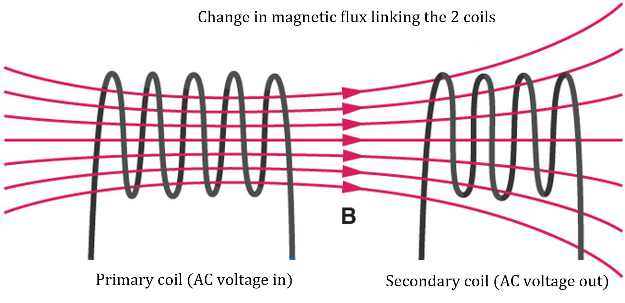

Slide 66
D
B
θ
C
A

Slide 67
Solar absorption spectrum
Typical band absorption
Continuous emission spectrum
Black absorption lines
Continuous emission spectrum
Black absorption bands

Slide 69
y
y'
v
Frame S
Frame S’
z
z
0
0
x
x'

Slide 70
Light path seen by driver
Light path seen by stationary observer
Stationary observer

Slide 71
Stationary observer

Slide 72
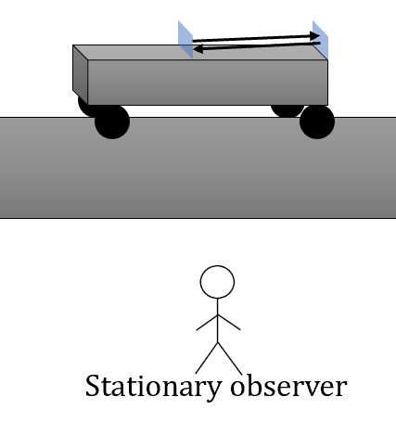
L₀
Light path for driver A→B→A in time t₀ = 2L₀ = ct₀
A
B
vt₁
L
Light path for stationary observer. Light leaves A, reflects off B’ and finally reaches A”. Mirrors move a distance of vt₁ and vt_{2.}
A
B
A→B’ in time t₁ = L + vt₁.
A’
B’
B’→A” in time t₂ = L – vt₂.
A”
B”

Slide 73
L
ct
L
vt

Slide 74
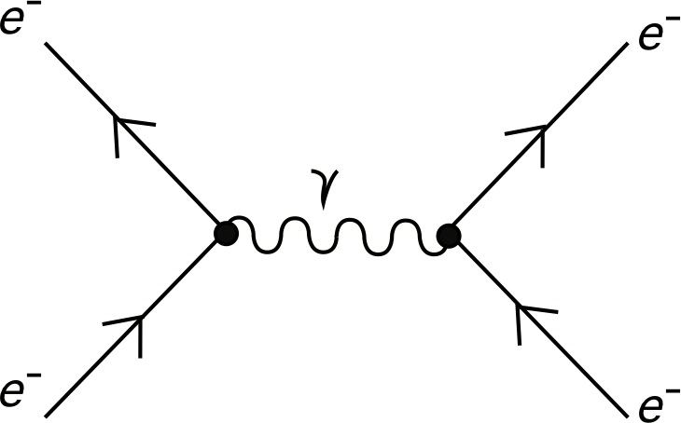
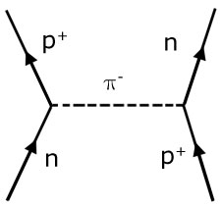
Time
Time
Position
Position

Slide 75
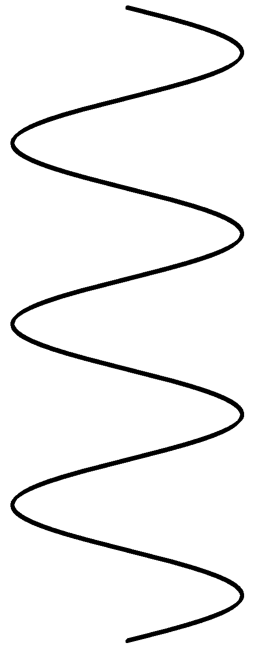
Heater filament
Cathode
Anode
High speed electron beam
Low voltage
to CRT screen or particle accelerator
High voltage

Slide 76
g_{parallel}
g
g_{perpendicular}
θ
θ

Slide 77
R
θ
F_{c}
mg
θ

Slide 79
Reaction rate
Forward reaction rate is high
N_{2 (g)} + 3H_{2 (g)} → 2NH₃ _{(g)}
Forward and reverse reaction rates become constant and equilibrium is established
2NH₃ _{(g)} → N_{2 (g)} + 3H_{2 (g)}
Time

Slide 80
Concentration of N₂ and H₂ decreasing rapidly initially
N₂
Concentration (mol L⁻¹)
Equilibrium established (concentrations constant)
H₂
NH₃
Concentration initially zero and then increases
Time (relative)

Slide 81
PCl_{5 (g)}
New equilibrium is reached
Concentration (mol L⁻¹)
Addition of Cl_{2 (g)}
Cl_{2 (g)}
PCl_{3 (g)}
Time
System at equilibrium

Slide 82
H_{2 (g)}
Concentration (mol L⁻¹)
H_{2 (g)}
N_{2 (g)}
N_{2 (g)}
NH_{3 (g)}
NH_{3 (g)}
Time
System at equilibrium
New equilibrium reached
Pressure increased by reducing volume

Slide 83
CO_{2 (g)}
Air
Water
Atmospheric CO_{2 (g)} dissolves in sea water and an equilibrium is established. Any increase in the concentration of CO_{2 (g)} in the atmosphere will also result in an increase in CO_{2 (aq)}.
The CO_{2 (aq)} reacts with water to form H₂CO_{3 (aq)} which partially ionises to form H₃O⁺_{(aq)}, HCO₃–_{(aq)} and CO₃^{2–}_{(aq)}.
Sea water naturally contains Ca²⁺_{(aq)} ions. Calcification:
Ca²⁺_{(aq)} + CO^{2–}_{(aq)} ⇌ CaCO_{3 (s)}
Higher ocean acidity can affect calcification as more CO₃^{2–}_{(aq)} ions are taken up by the extra H⁺_{(aq)} ions.
H⁺_{(aq)} + CO₃^{2–}_{(aq)} ⇌ HCO₃–_{(aq)}
CO_{2 (aq)}

Slide 84
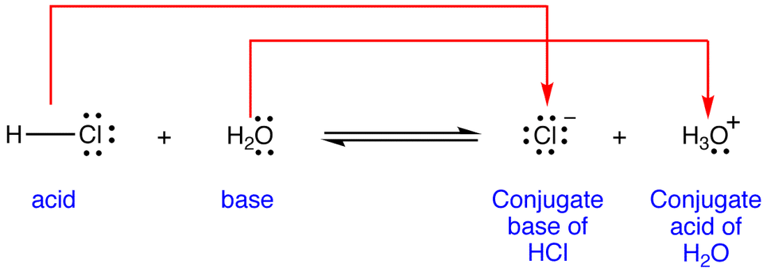
Conjugate pair
Conjugate pair

Slide 85
Titration Na₂CO₃ + HCl
Titration HCl + NaOH
Primary standard Na₂CO₃
Standardised HCl
Standardised NaOH
Prepared by dissolving an accurately weight amount of Na₂CO₃ and making up to an exact volume using a volumetric flask.
Titration to determine concentration of unknown solutions
e.g., %NH₃ in household cleaner
e.g., %CH₃COOH in vinegar

Slide 86
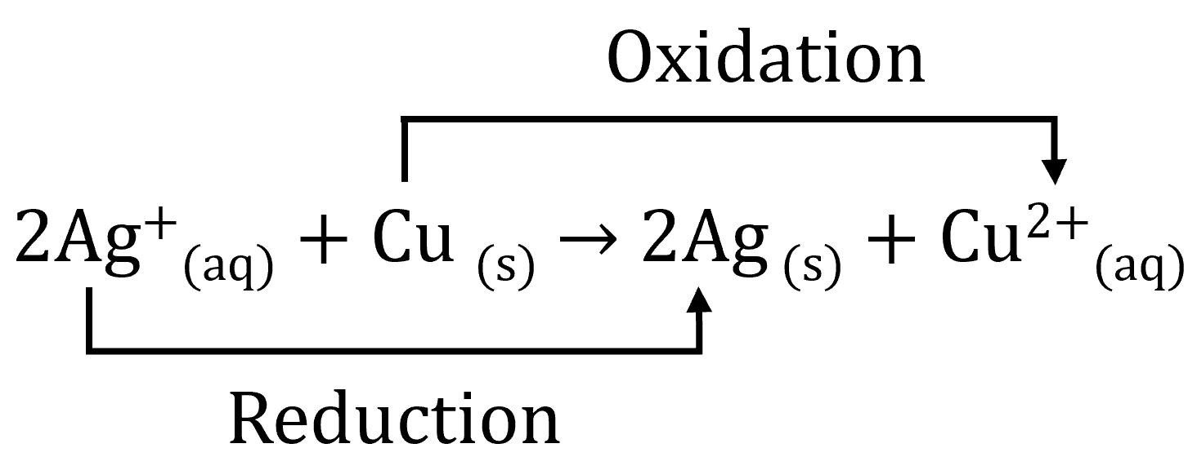
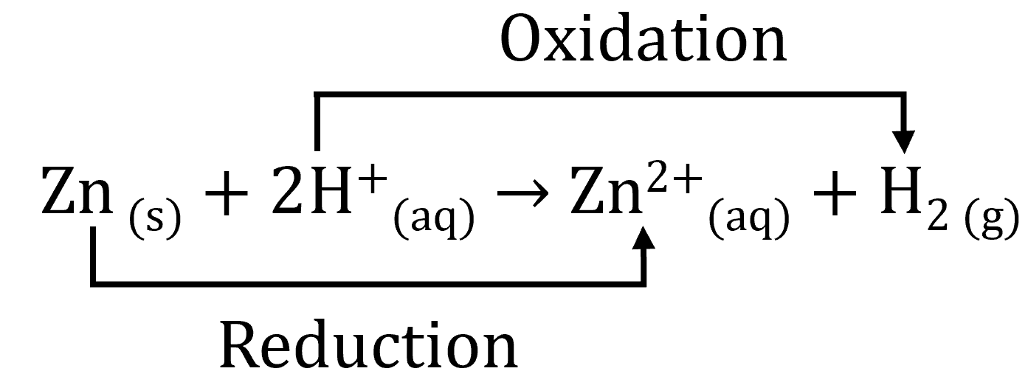
e–
Oxidant
Reductant
2e–
Is oxidised
Is reduced
2e–
Reduction
2e–
Oxidation
PbO _{(s)} + CO _{(g)} → Pb _{(s)} + CO_{2 (g)}
Oxidation
Reduction

Slide 87
A
A
r
r
θ
θ
C
O
r
B
O
r
B

Slide 88
Cu _{(s)} + 4H⁺_{(aq)} + 2NO₃– → 2NO_{3 (g)} + Cu²⁺_{(aq)} + 2H₂O _{(l)}
0
+1
+5 –2
+4 –2
+2
+1 –2
Reduction (–1)
Oxidation (+2)

Slide 89
Cu _{(s)} + 4H⁺_{(aq)} + 2NO₃– → 2NO_{3 (g)} + Cu²⁺_{(aq)} + 2H₂O _{(l)}
0
1
5 –2
4 –2
2
1 –2
Reduction (–1)
Oxidation (+2)

Slide 90
Reduction (–1)
H₂O_{2 (aq)} + H₂O_{2 (aq)} → 2H₂O _{(l)} + O_{2 (g)}
1
–1
1
–1
1
–2
0
Reduction (–1)
Oxidation (+1)
Cu⁺_{(aq)} + Cu⁺_{(aq)} → Cu²⁺_{(aq)} + Cu _{(s)}
1
1
1
Oxidation (+1)

Slide 91
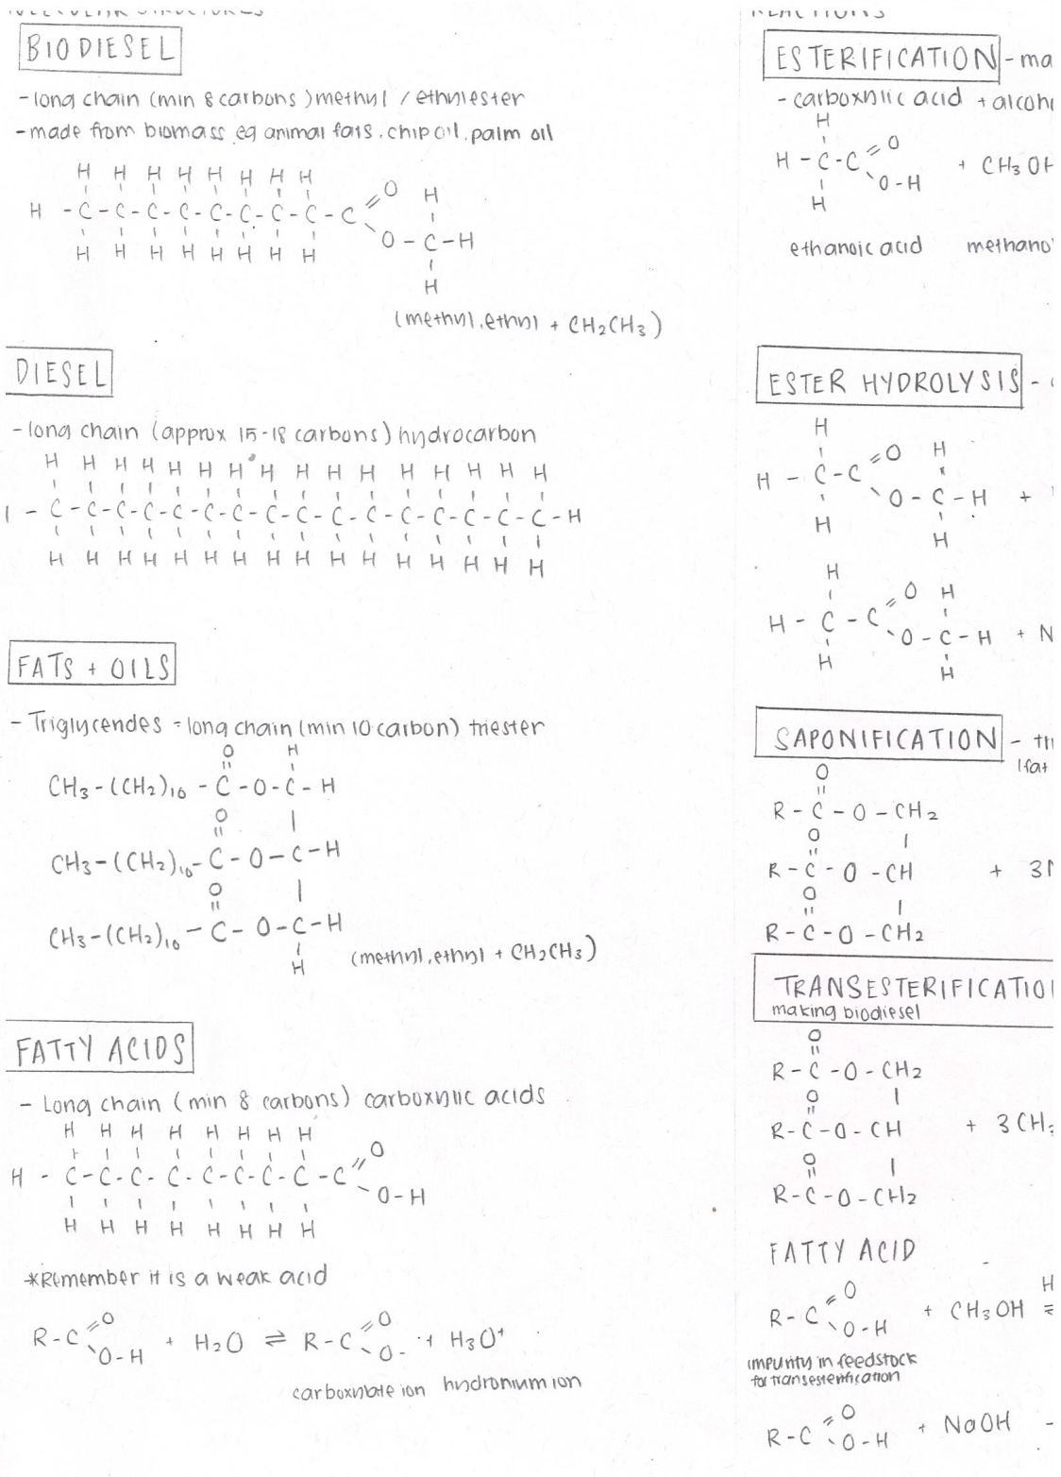
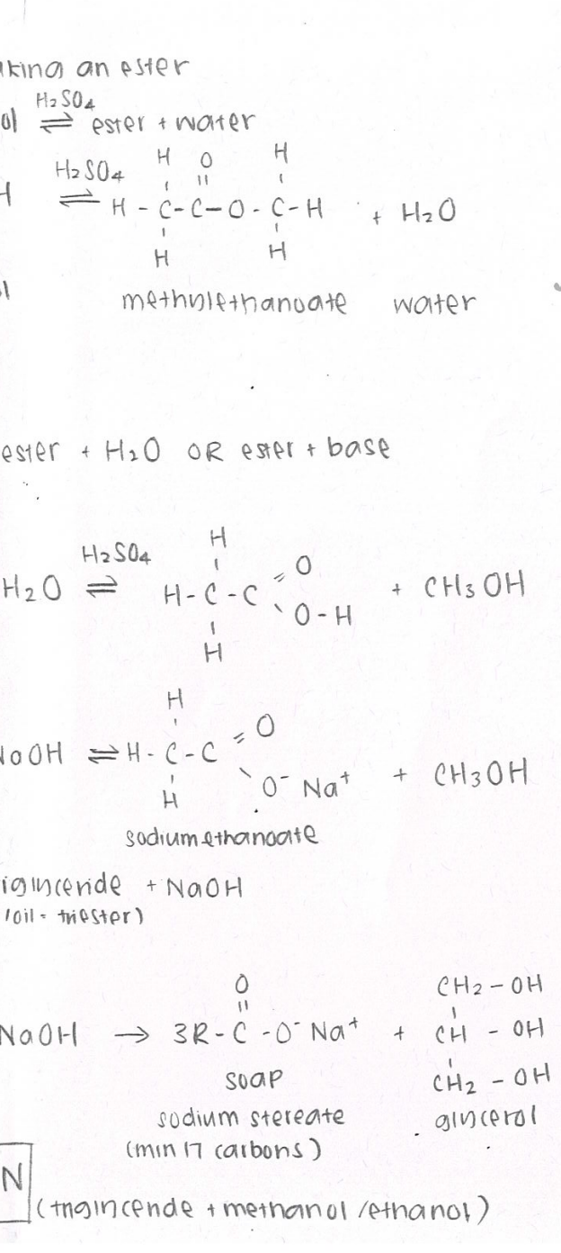

Slide 92
F_{c}
W
F_{h}(horizontal)
F_{N}
16º
185
74º
16º

Slide 93
Cannibal
Carib

Slide 94
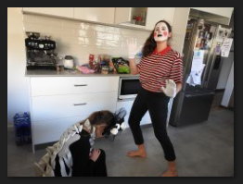

Slide 95
Paragraph 1
Loggers
Environmental perspective
(Include evaluation)
Paragraph 1
Paragraph 2
Environmental perspective
(Include evaluation)
Feminist perspective
(Include evaluation)
Paragraph 2
Greenies
Paragraph 3
Masculinity
Feminist perspective
(Include evaluation)
Paragraph 4
Femininity
Paragraph 1
Paragraph 2
Paragraph 3
Environmental perspective: Loggers & Greenies
Include evaluation (why it’s important)
Feminist perspective: Masculinity
Include evaluation (why it’s important)
Feminist perspective: Femininity
Include evaluation (why it’s important)
Note: You can do “Masculinity & Femininity”,
“Loggers” and then “Greenies” i.e., swapped.
Paragraph 1
Paragraph 2
Paragraph 3
Environmental perspective: Loggers & Greenies
Feminist perspective: Masculinity & femininity
Evaluation

