Slide 1
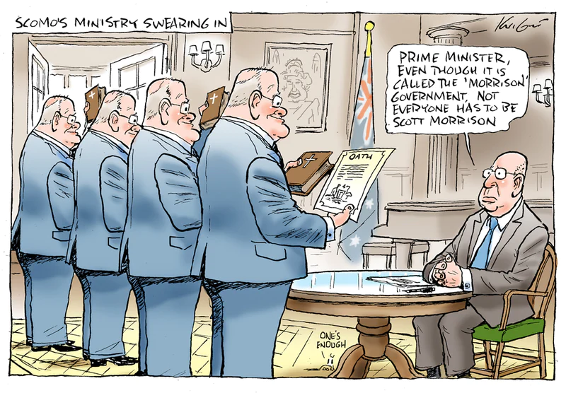
Humanities and Social Sciences
Year 11 ATAR
10. Australia’s System of Government:
Responsible Parliamentary Government

Slide 2
Title: Australia’s System of Government - Responsible Parliamentary Government
EQ: What are the features of a Responsible Government in the Australian Political and Legal System?
Key Word [headings on slides]
Notes
Homework (Do not rule up this section until we are finished with notes):
Answer EQ in Summary section
Title
EQ
Keywords
Notes
Homework

Slide 3
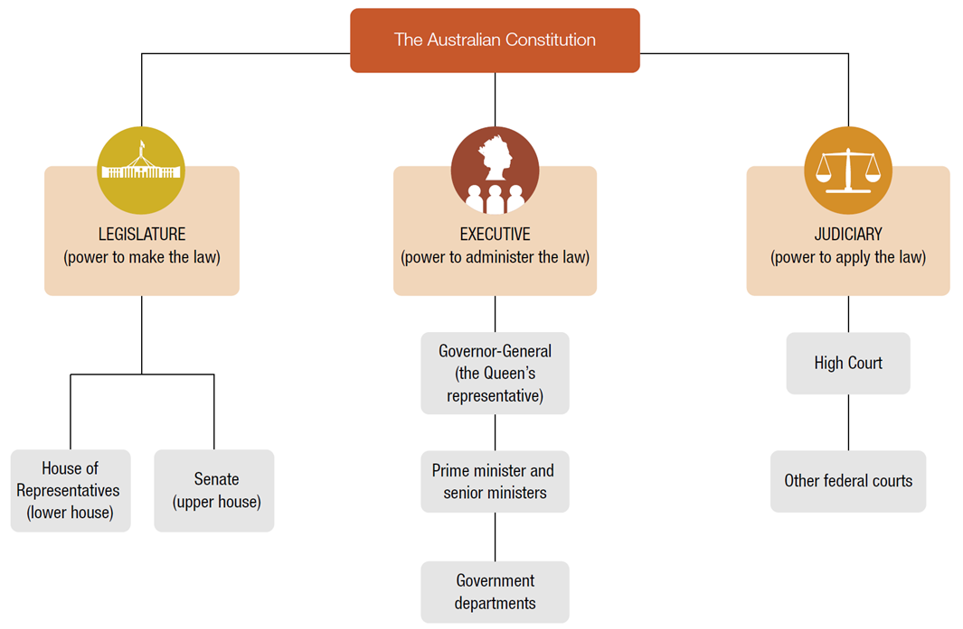
The Structure of the Australian Government

Slide 4
The Executive
CHECK FOR UNDERSTANDING
What does the text mean by ‘formal’ and ‘real’?
The executive has three key elements:
Constitutional (formal) executive = the Monarch and the Governor General
Political (real) executive = Prime Minister and Cabinet
Administrative executive = Public Service (government departments and workers)

Slide 5
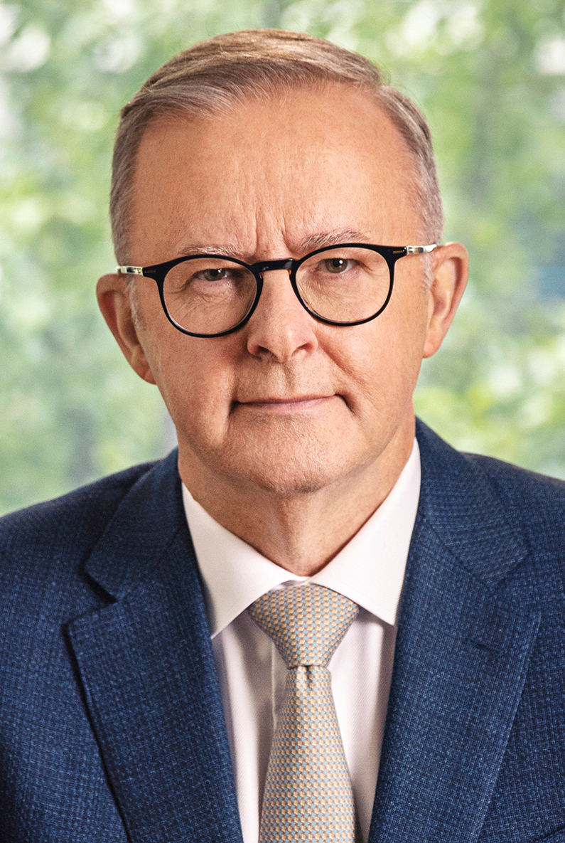
Government in Australia
When people talk about the government, generally they are referring to the executive arm of government.
In Australia, the leader of the party / coalition with the most seats in the lower house of parliament will become the Prime Minister, has the role of the ‘Head of Government’ and…
"determines / coordinates policy and the administration of government."
CHECK FOR UNDERSTANDING
Who is Australia’s current PM and which party do they belong to?
Anthony Albanese Australian Prime Minister since 23 May 2022

Slide 6
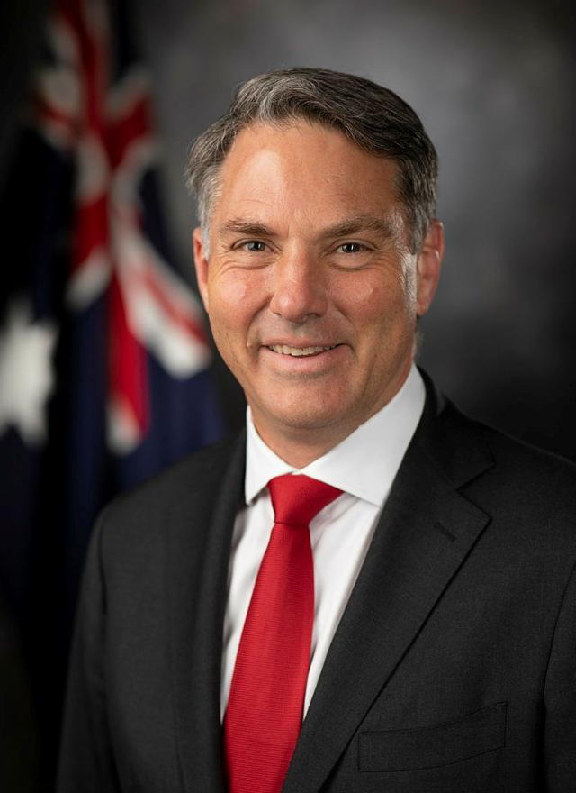
The Prime Minister
The Prime Minister is the leader of the Australian Government and is a member of the House of Representatives
Our current Prime Minister is Anthony Albanese who was sworn in by the Governor-General on 23 May 2022, and is the leader of the Labor party.
The Deputy Labor leader is Richard Marles
Australia has had 31 prime ministers since Federation in 1901
The role of PM is not mentioned in the Australian Constitution, instead, the Prime Minister works according to practices and customs that developed over hundreds of years in the British Parliament and were then adopted by the Australian Parliament (Conventions)
Party leaders are chosen depending on the election process of their political party
https://youtu.be/897DD33ezjU (2:07 mins).
Deputy PM Richard Marles
CHECK FOR UNDERSTANDING
Who is the leader of the current Australian government? What is the role of the PM based on?

Slide 7
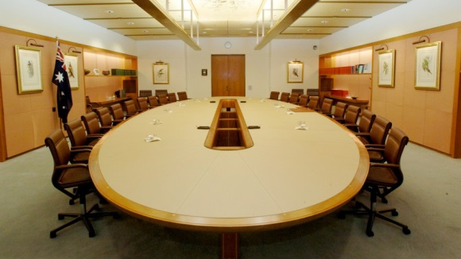
The Cabinet
Cabinet is the top-level decision-making group within the Australian Government. It includes the prime minister and 21 ministers who are part of the executive government.
Cabinet ministers are responsible for major government departments such as treasury, defence, education, health, environment and many more.
Cabinet's role is to direct government policy, make decisions about national issues, present bills prepared by their government departments to Cabinet who then considers these bills and recommends to whether the bills should be introduced into Parliament or if changes should be made first.
The Cabinet is not mentioned in the constitution, so all Cabinet ministers also belong to the Executive Council (which is chaired by the Governor-General) where decisions already made in the Cabinet are endorsed.
Cabinet is important because over time it had emerged as a way of limiting the power of the monarch.
It is the most powerful institution in a Westminster system of government.

Slide 8
Ministers
CHECK FOR UNDERSTANDING
What are the two types of ministers?
There are three types of government ministers:
Cabinet ministers (sometimes called senior ministers), who are in charge of major departments, for example, the Treasurer
Junior ministers, are part of the ‘outer ministry’. They assist Cabinet ministers with particular areas of their ‘portfolio’ (area of responsibility). Junior ministers are not members of Cabinet, though they do occasionally attend Cabinet meetings. Members of the outer ministry are not members of the executive, only cabinet members are
Cabinet ministers are assisted by parliamentary secretaries, also known as assistant ministers. Parliamentary secretaries are also not members of the executive
All ministers including cabinet, junior and parliamentary secretaries have the title ‘Honorable’ which they then keep for life. For example, the Treasurer is called the Honorable (or Hon.) Dr. Jim Chalmers.
CHECK FOR UNDERSTANDING
What are senior ministers / cabinet ministers responsible for?
CHECK FOR UNDERSTANDING
What do junior ministers do?
https://www.abc.net.au/btn/classroom/government-ministers/14024502?jwsource=cl (4:22 mins).

Slide 9
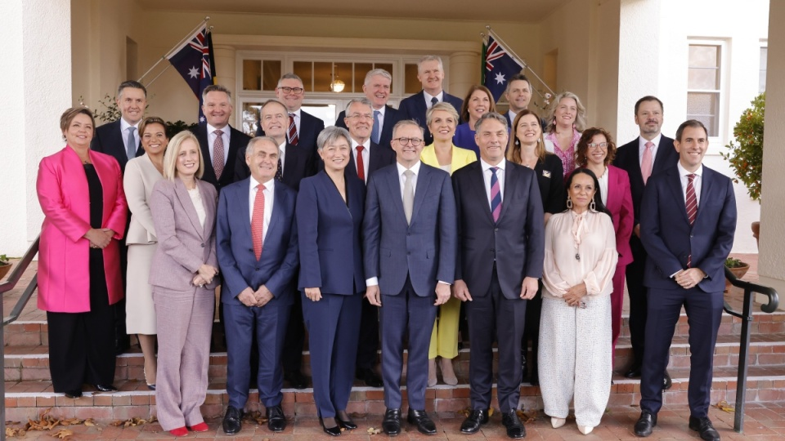
Albanese Ministry / Cabinet
CHECK FOR UNDERSTANDING
Who is in Cabinet?
CHECK FOR UNDERSTANDING
What does Cabinet do?
CHECK FOR UNDERSTANDING
Which part of parliament do cabinet ministers belong to?
Albanese Government Cabinet Ministers as of 2022

Slide 10
Responsible Government
CHECK FOR UNDERSTANDING
Which MPs are members of the executive and what are they called?
Responsible Government: The convention governing the formation of government in the Westminster system in which the executive is drawn from and responsible to the parliament.
Westminster System: A system of government based on the British Westminster system. The executive is drawn from within the legislature and holds it responsible between elections. This is referred to as ‘responsible parliamentary government’. Distinguished by the fusion of the legislative and executive powers, and the relatively weak separation between these two branches of government.
Westminster Conventions: Unwritten constitutional rules that govern the practice of government in systems derived from the British Westminster system.

Slide 11
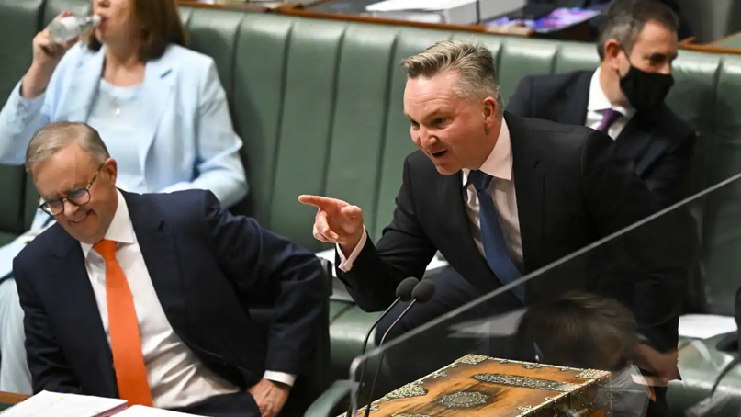
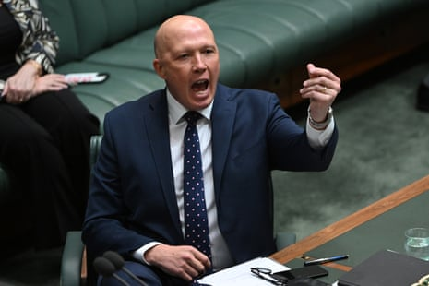
Responsible Government
According to the Westminster system, the term ‘responsible government’ refers to the executive government being directly drawn from the legislature and being held responsible to the parliament.
In a responsible parliamentary system, parliamentarians also have a role of questioning and scrutinising the government each sitting day via Question Time and parliamentary committees.
Responsible government in Canada: https://youtu.be/cinl2PwTlBA 2:40 minutes
Australian Climate Change Minister Chris Bowen speaks during House of Representatives Question Time at Parliament House in Canberra, Tuesday, August 2, 2022
Opposition Leader Peter Dutton speaks during House of Representatives Question Time at Parliament House in Canberra, Wednesday 26 October 2022

Slide 12
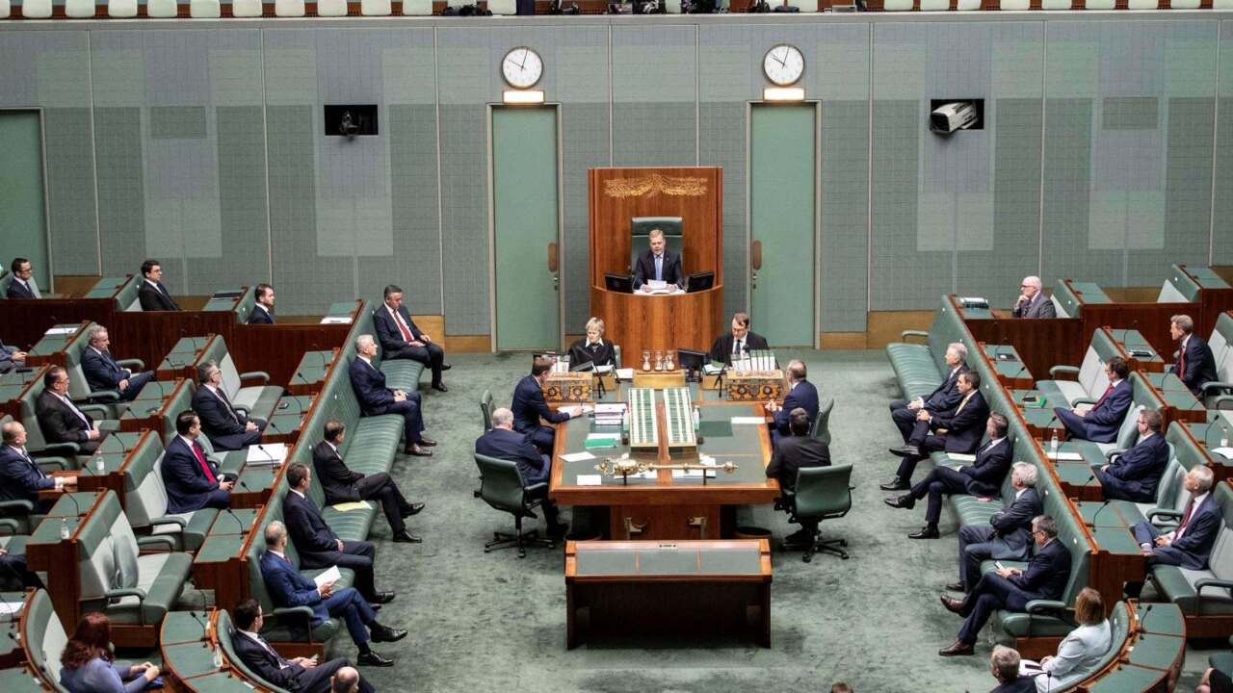
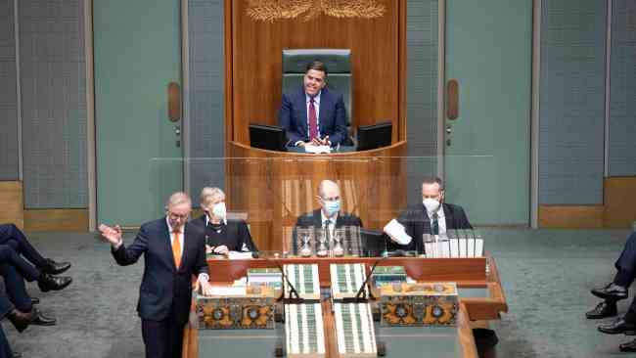
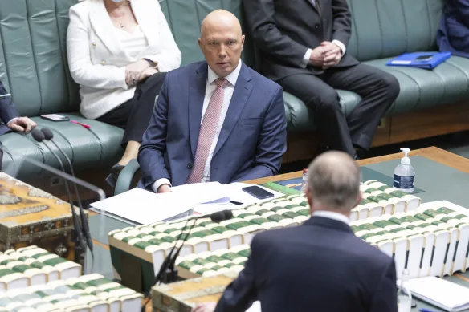
Question Time
When in the House of Representatives, the Prime Minister sits at the central table in front of the government and directly opposite the Leader of the Opposition
As the head of the Australian Government, they take the lead in presenting major speeches to Parliament about government policy
The Prime Minister and his ministers also answer many questions during Question Time - a period of time every ‘sitting’ day where members from the opposition parties can ask the PM and the government ministers questions about the departments they are responsible for - their portfolios.
CHECK FOR UNDERSTANDING
What is the purpose of Question Time?

Slide 13
Responsible Government
The operation of a responsible parliamentary government operates almost entirely according to unwritten conventions (rules).
Chapter 2 of the Commonwealth Constitution, which establishes the executive, says nothing about how executive power works in reality.
Key elements of a responsible government include:
Individual Ministerial Responsibility (IMR)
Collective Ministerial Responsibility (CMR).

Slide 14
Individual Ministerial Responsibility
The House has a whole range of powers to sanction MPs, and holding individual ministers to account for their performance, ranging from suspension all the way up to imposing six-month jail terms. Question time, debate, and Committees are all methods used to hold ministers responsible.
Ministers can also have a Censure motions raised against them. A Censure is raised in the relevant house, the behaviour debated and then the house holds a vote as to whether the minister should be censured or not.
If passed, Censures have no direct powers but that’s not to say they have no impact; symbolism can be important in politics. Because they’re so rare, the motions draw a lot of attention which can add to broader pressure on their target.
A censure motion can also lead to retirement from office.
The media can also be a helpful tool in accountability of ministers by investigating and drawing the public’s attention to doubtful behaviour.

Slide 15
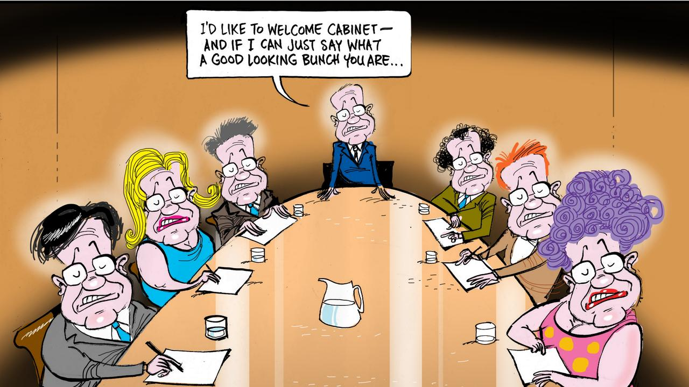
Individual Ministerial Responsibility
Scott Morrison became the first former Australian PM to ever be censured by the House of Representatives. This was for appointing himself to five ministries between March 2020 to May 2021, mostly without the knowledge of the minister already holding the portfolio, and without the knowledge of Parliament as a whole – except the Governor General who swore him in. https://youtu.be/ALYY6S0c3mY 7:30 minutes.
CHECK FOR UNDERSTANDING
What is a censure motion and what impact does it have if passed?
List of all Federal Government Ministers who have been censured: https://australianpolitics.com/executive/ministerial-resignations-and-dismissals-since-1901

Slide 16
Collective Ministerial Responsibility
Parliament may hold the entire government accountable for its operations.
If a government is incompetent or corrupt the parliament may hold them accountable via a motion of no confidence.
An essential element of a responsible parliamentary government is that the government must maintain the confidence of the lower house.
However, it is difficult for a motion of no confidence to be passed without a majority of votes in the House of Representatives which is why it rarely happens.
Gogh Whitlam’s dismissal from government 1975: https://youtu.be/SXq056TJhU4 4:31 minutes
https://www.smh.com.au/culture/musicals/what-s-the-song-and-dance-about-the-dismissal-20221212-p5c5l9.html 1:32 minutes
CHECK FOR UNDERSTANDING
What is a motion of no confidence?
CHECK FOR UNDERSTANDING
How is a motion of no confidence passed?
CHECK FOR UNDERSTANDING
What are the consequences of a vote of no confidence?

Slide 17
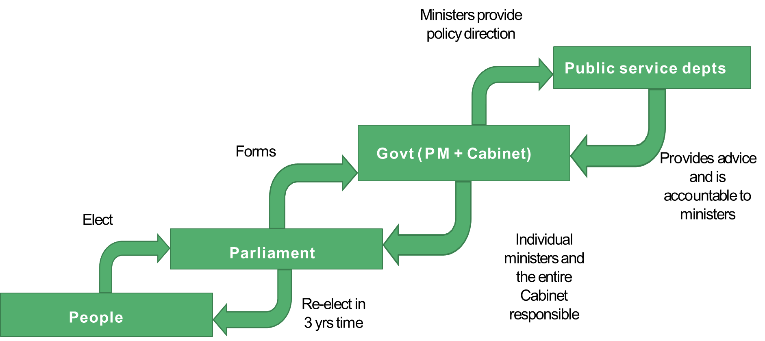
Appropriation
A final element of a responsible government relates to appropriation.
The government is unable to spend money in Australia unless it has been approved by parliament through the normal passage of a bill.
Governments require money for the administration of the laws and to carry out their policies.
The Westminster Chain of Responsibility

Slide 18
Parliamentary Government
Parliamentary government refers to where government is formed – in Australia government is formed within the legislative branch of government.
In Australia there is a fusion between the legislative and executive branches.
Reminder – whichever party(ies) holds a majority of seats in the lower house forms the government.
This means that members of government must also be members of parliament.
Although parliamentarians have different functions to members of the executive, the separation of powers is weaker than other systems of government e.g. USA.

Slide 19
Read pages 41 – 50 of your text book.
Explain what the terms ‘responsible’ and ‘parliamentary’ mean in the term ‘responsible parliamentary democracy.
Describe the ways that government can be held accountable in Australia.
Outline the ‘chain of responsibility’ in the Westminster System.
Outline the links between the legislature and the executive and how power is exercised.

